Slide 1

Flutter-Workshop
Julian Hartl

Slide 2
Overview
Why Flutter?
Flutter Basics
Dart Crash-Course
Developing a Shopping List app
Building your own app
Outlook

Slide 3
Why Flutter?
What even is Flutter?

Slide 4
What even is Flutter?
“Flutter is an open source framework by Google for building beautiful, natively compiled, multi-platform applications from a single codebase.”

Slide 5
What even is Flutter?
“Flutter is an open source framework by Google for building beautiful, natively compiled, multi-platform applications from a single codebase.”
Open source UI software development toolkit
Supports many platforms
Single codebase

Slide 6

Why Flutter?
What is your experience with app development, and what are your expectations for the workshop?
Notes:
Was sind eure Erfahrung mit App Entwicklung?
Was erhofft ihr euch von diesem Workshop?

Slide 7
Why Flutter?
What does Flutter offer?

Slide 8
What does Flutter offer?
Cross-Platform development (Android, iOS, Web, Windows, macOS, Linux, Fuchsia)

Slide 9
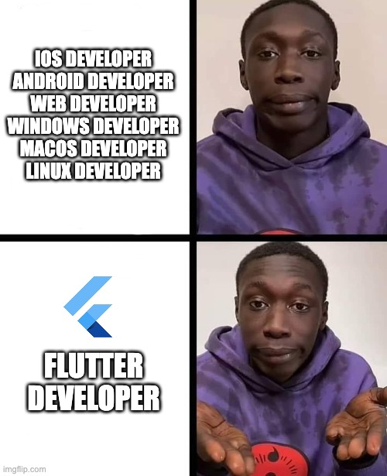
What does Flutter offer?
Cross-Platform development (Android, iOS, Web, Windows, macOS, Linux, Fuchsia)

Slide 10
What does Flutter offer?
Cross-Platform development (Android, iOS, Web, Windows, macOS, Linux, Fuchsia)
Performant due to Ahead-of-Time (AOT) Compilation

Slide 11
What does Flutter offer?
Cross-Platform development (Android, iOS, Web, Windows, macOS, Linux, Fuchsia)
Performant due to Ahead-of-Time (AOT) Compilation
Expressive and flexible UI (large set of prebuilt components)

Slide 12
What does Flutter offer?
Cross-Platform development (Android, iOS, Web, Windows, macOS, Linux, Fuchsia)
Performant due to Ahead-of-Time (AOT) Compilation
Expressive and flexible UI (large set of prebuilt components)
Hot reload (instant UI updates)

Slide 13
What does Flutter offer?
Cross-Platform development (Android, iOS, Web, Windows, macOS, Linux, Fuchsia)
Performant due to Ahead-of-Time (AOT) Compilation
Expressive and flexible UI (large set of prebuilt components)
Hot reload (instant UI updates)
Consistent behavior across all platforms

Slide 14
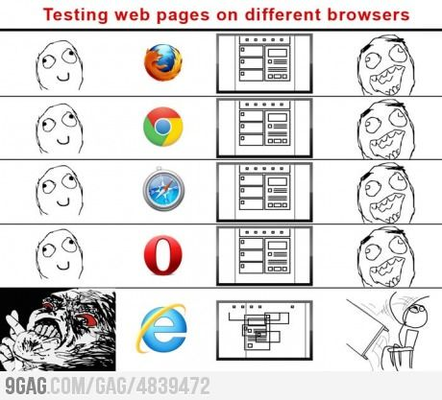
What does Flutter offer?
Cross-Platform development (Android, iOS, Web, Windows, macOS, Linux, Fuchsia)
Performant due to Ahead-of-Time (AOT) Compilation
Expressive and flexible UI (large set of prebuilt components)
Hot reload (instant UI updates)
Consistent behavior across all platforms

Slide 15
What does Flutter offer?
Cross-Platform development (Android, iOS, Web, Windows, macOS, Linux, Fuchsia)
Performant due to Ahead-of-Time (AOT) Compilation
Expressive and flexible UI (large set of prebuilt components)
Hot reload (instant UI updates)
Consistent behavior across all platforms
Strong community and ecosystem (wide adoption in the industry)

Slide 16
Why Flutter?
Applications in the real world

Slide 17

BMW
Feature and design discrepancies between their iOS and Android offering had grown too large
💭 Not yet mature enough
✅ Not web based => better UX
✅ Build & design once

Slide 18
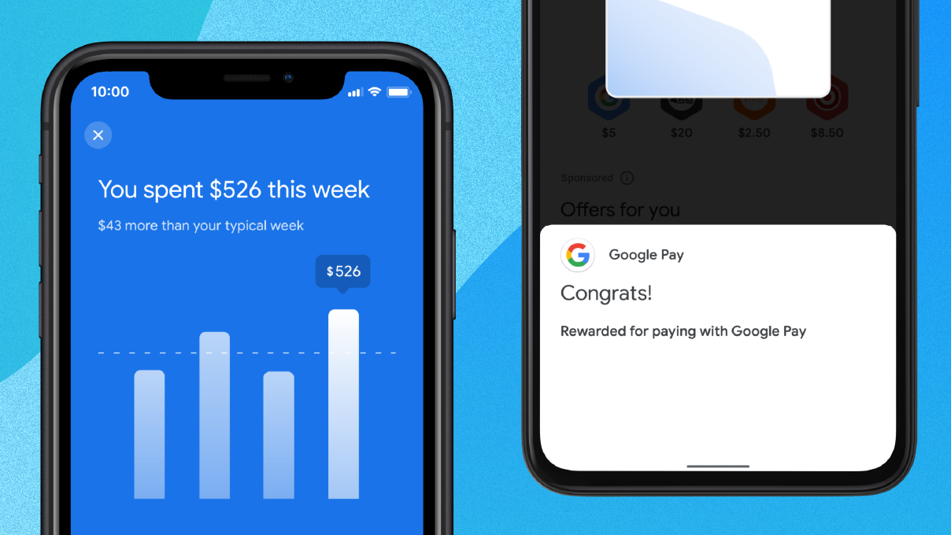
Google-Pay
Building every feature twice
💭 Heavy upfront investment of engineering resources (retraining, reapproval, …)
✅ 70% reduction in engineering effort
✅ 35% reduction in lines of code
✅ Saved about 60-70% of their engineer’s time

Slide 19
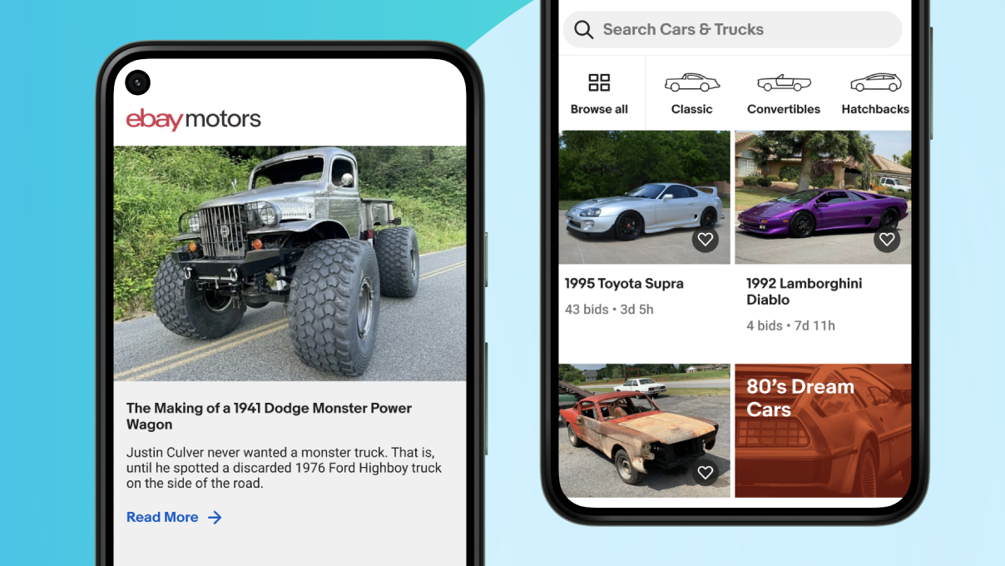
eBay
Building a new app to buy and sell hard-to-find cars for both Android and iOS in under a year
✅ Time-saving and design capabilities
✅ Hot reload
✅ Built-in testing
✅ Code sharing

Slide 20
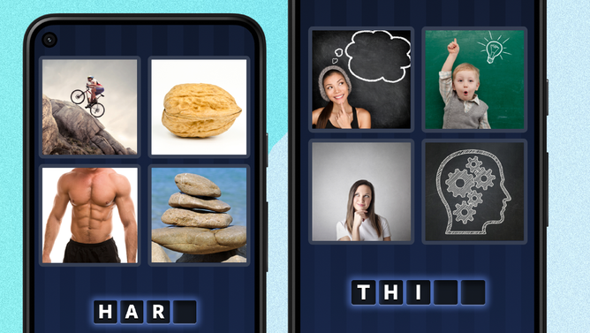
4 Pics 1 Word
Giving 4 Pics 1 Word a tuneup
✅ No more troubleshooting cross-platform functionality
✅ Performs offline on low-end devices
✅ 99.9% crash-free rate

Slide 21
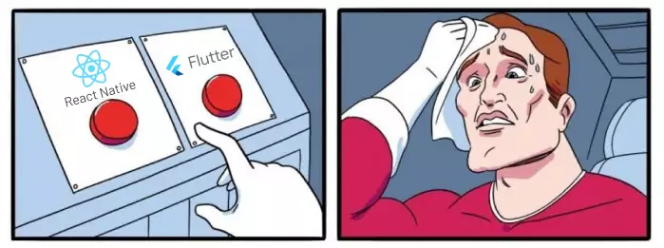
Why Flutter?
Flutter compared to React Native

Slide 22
Flutter vs. React Native
Flutter
React Native
Comprehensive set of prebuilt UI components following Material Design & Cupertino guidelines
Core components, but for more complete UI, developers often rely on third-party libraries

Slide 23
Flutter vs. React Native
Flutter
React Native
Comprehensive set of prebuilt UI components following Material Design & Cupertino guidelines
AOT compiled to native code, ensuring faster startup and performance
Core components, but for more complete UI, developers often rely on third-party libraries
Uses JavaScript, which is interpreted at runtime and therefore only close to native performance

Slide 24
Flutter vs. React Native
Flutter
React Native
Comprehensive set of prebuilt UI components following Material Design & Cupertino guidelines
AOT compiled to native code, ensuring faster startup and performance
Has a powerful graphics engine (Skia) that supports complex customizations and graphics (animations, …)
Core components, but for more complete UI, developers often rely on third-party libraries
Uses JavaScript, which is interpreted at runtime and therefore only close to native performance
While possible, achieving the same level of complexity as Flutter might require additional work & third-party libraries

Slide 25
Flutter vs. React Native
Flutter
React Native
Comprehensive set of prebuilt UI components following Material Design & Cupertino guidelines
AOT compiled to native code, ensuring faster startup and performance
Has a powerful graphics engine (Skia) that supports complex customizations and graphics (animations, …)
Although younger, it has a rapidly growing community
Core components, but for more complete UI, developers often rely on third-party libraries
Uses JavaScript, which is interpreted at runtime and therefore only close to native performance
While possible, achieving the same level of complexity as Flutter might require additional work & third-party libraries
Established community with a vast number of libraries

Slide 26
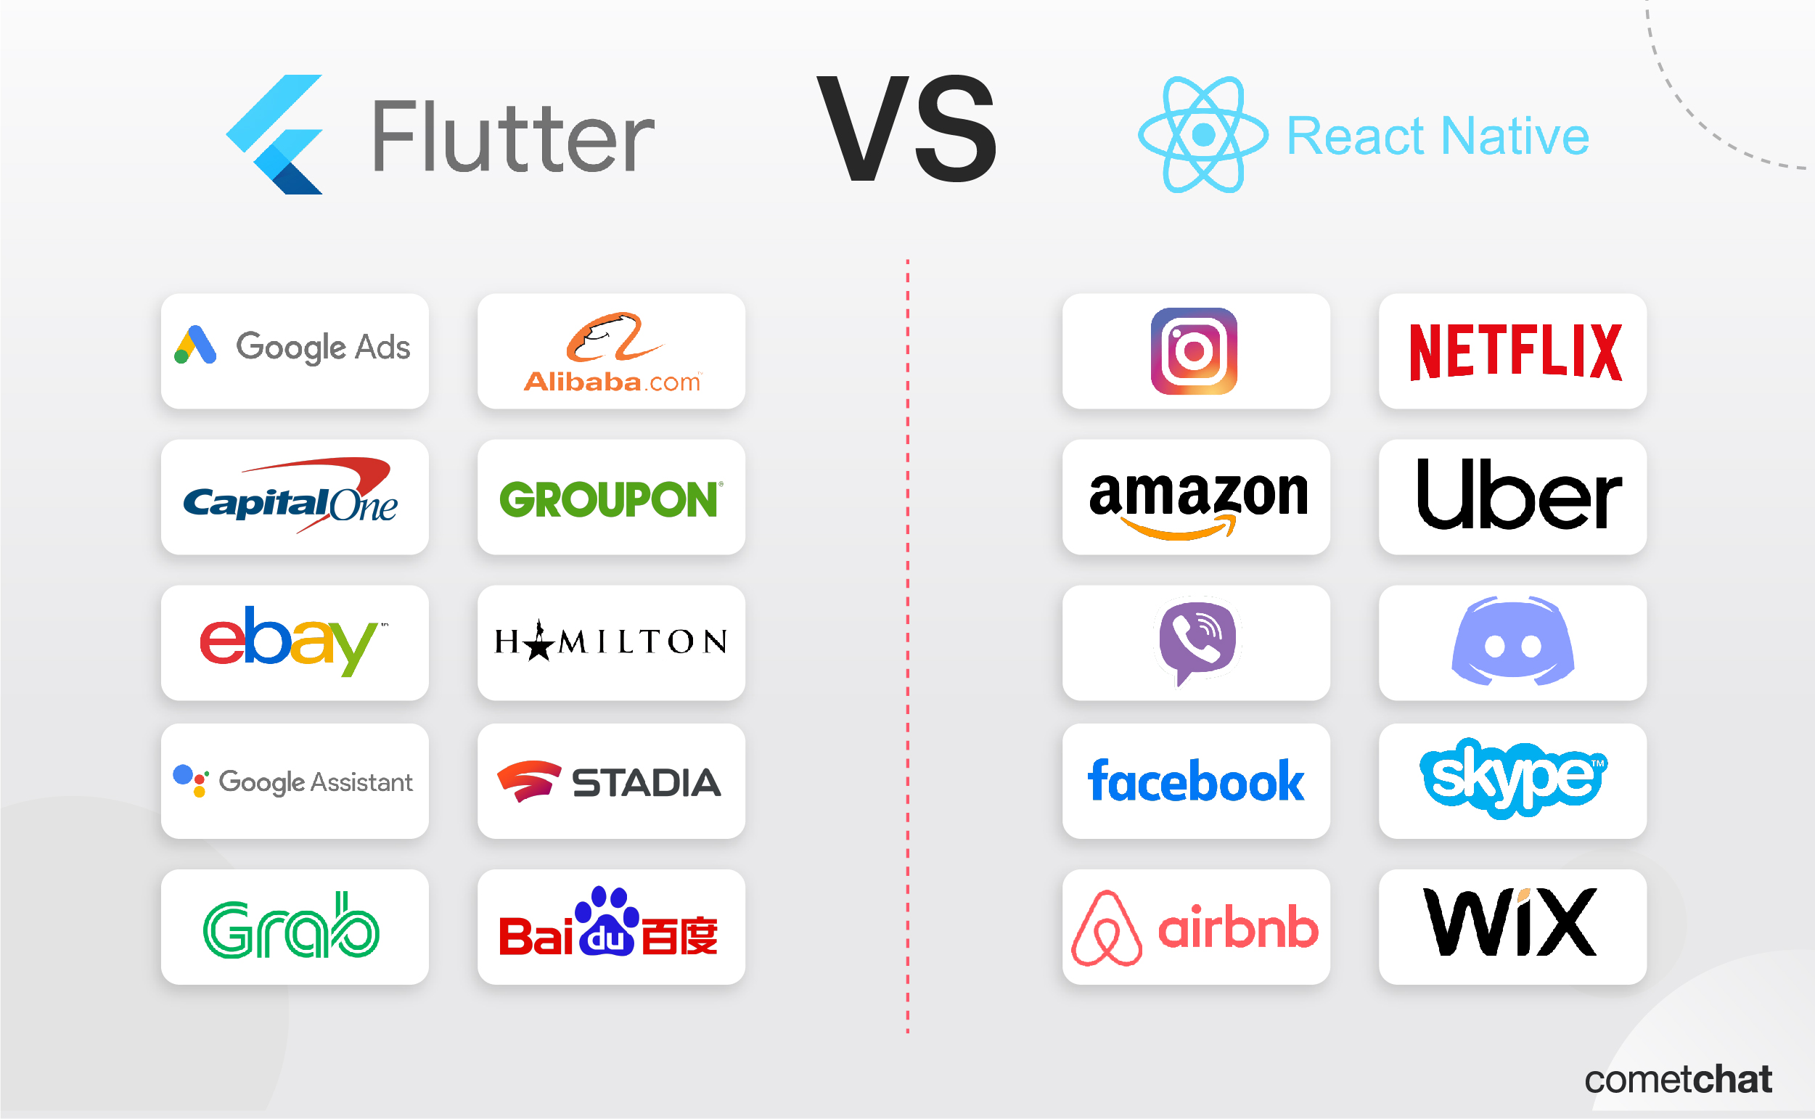
Flutter vs. React Native

Slide 27
Why Flutter?
Flutter compared to native development

Slide 28
Flutter vs. Native
Flutter
Native
Cross-Platform
Supports only one platform

Slide 29
Flutter vs. Native
Flutter
Native
Cross-Platform
Consistent design
Supports only one platform
Design can vary between devices

Slide 30
Flutter vs. Native
Flutter
Native
Cross-Platform
Consistent design
One codebase
Supports only one platform
Design can vary between devices
Two separate codebases

Slide 31
Flutter vs. Native
Flutter
Native
Cross-Platform
Consistent design
One codebase
May require additional work for platform-specific features
Supports only one platform
Design can vary between devices
Two separate codebases
Direct access to native functionalities

Slide 32
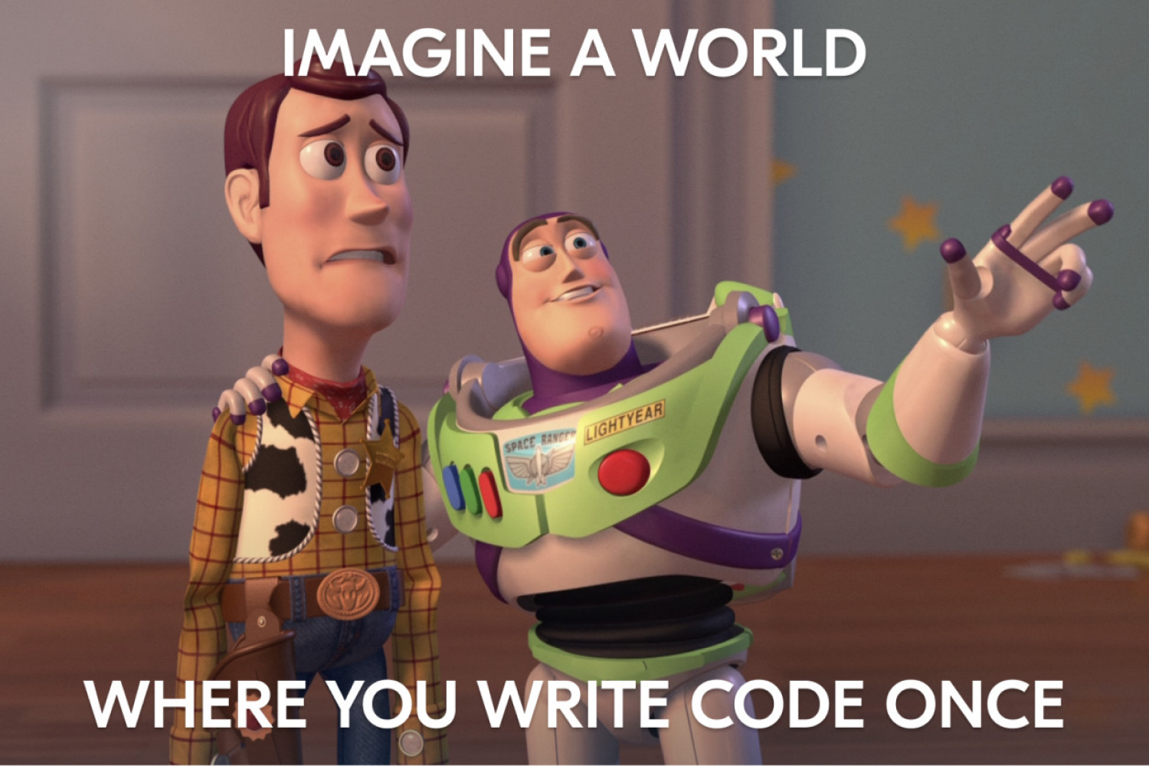
Summary
Build once for all platforms
Native performance
Rich ecosystem & wide adoption
Consistent design due to Skia Rendering-Engine

Slide 33
Flutter Basics
Widgets

Slide 34
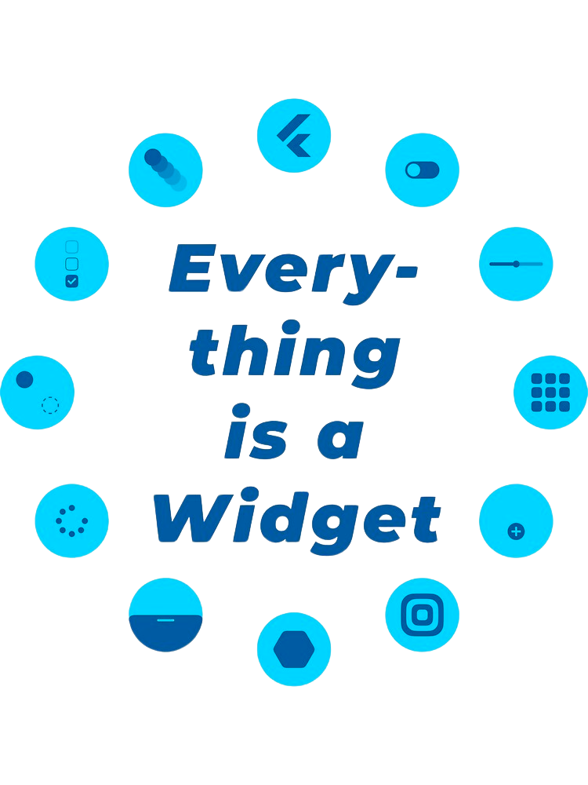
Notes:
jeder Screen besteht aus einer Vielzahl an Widgets

Slide 35
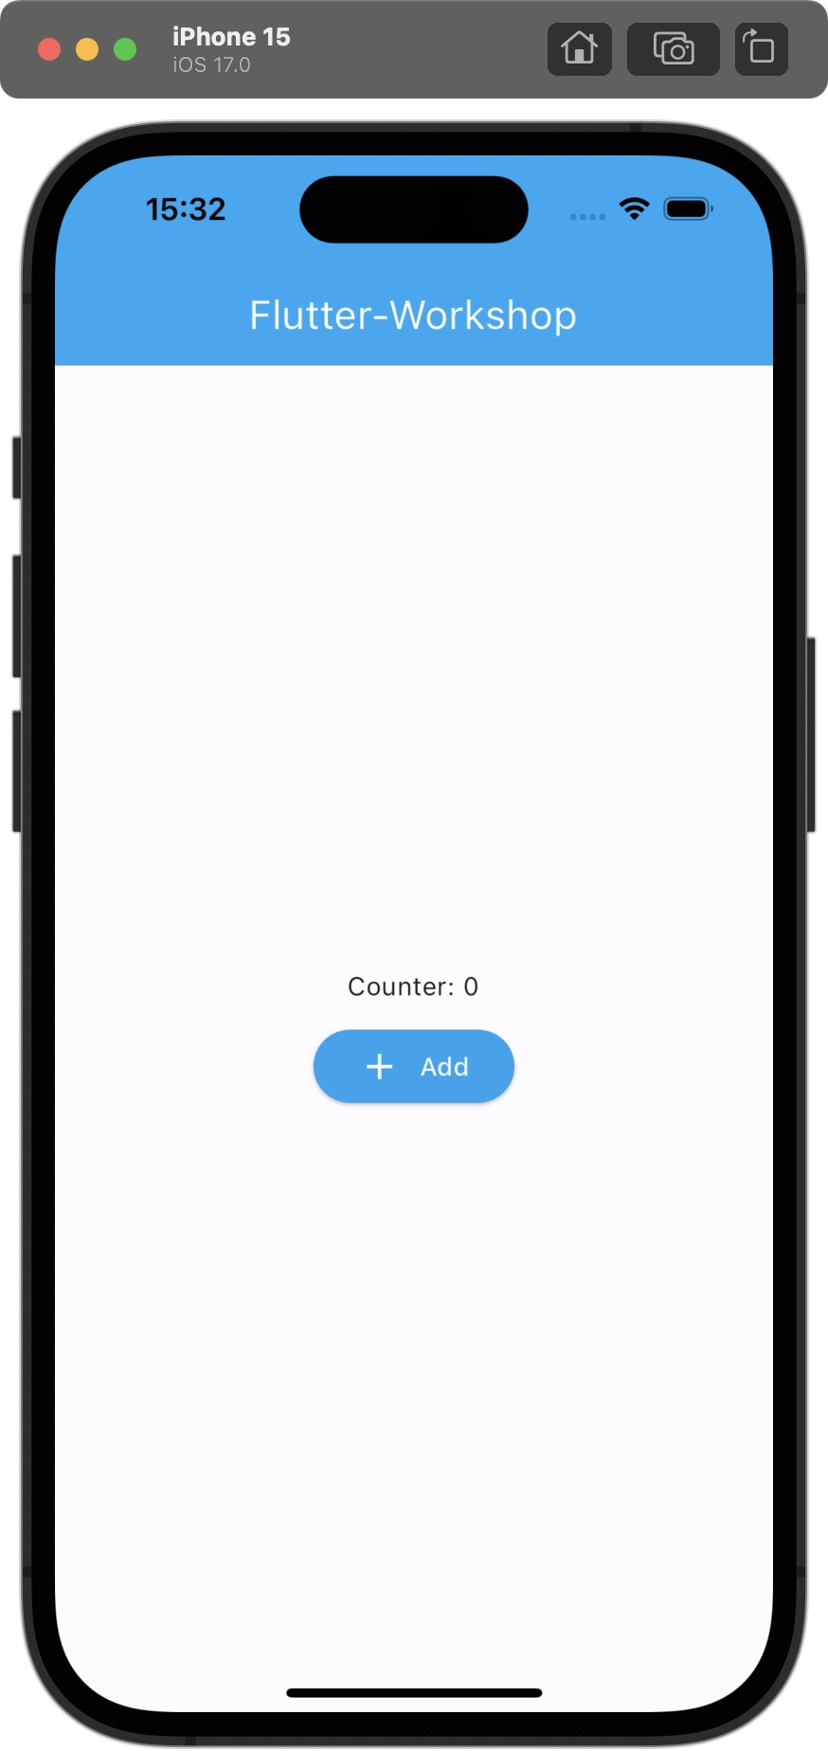

Slide 36
Root Widget

Slide 37
Root Widget

Slide 38
Root Widget
AppBar Widget

Slide 39
Root Widget
AppBar Widget
Text Widget

Slide 40
Root Widget
AppBar Widget
Center Widget
Text Widget

Slide 41
Root Widget
AppBar Widget
Center Widget
Text Widget
Column Widget

Slide 42
Root Widget
AppBar Widget
Center Widget
Text Widget
Column Widget
Text Widget

Slide 43
Root Widget
AppBar Widget
Center Widget
Text Widget
Column Widget
Text Widget
ElevatedButton Widget

Slide 44
Root Widget
AppBar Widget
Center Widget
Column Widget
Text Widget
ElevatedButton Widget
Text Widget
Row Widget

Slide 45
Root Widget
AppBar Widget
Center Widget
Column Widget
Text Widget
ElevatedButton Widget
Text Widget
Row Widget
Icon Widget

Slide 46
Root Widget
AppBar Widget
Center Widget
Column Widget
Text Widget
ElevatedButton Widget
Text Widget
Row Widget
Icon Widget
Text Widget

Slide 47
Root Widget
AppBar Widget
Center Widget
Column Widget
Text Widget
ElevatedButton Widget
Text Widget
Row Widget
Icon Widget
Text Widget

Slide 48
Widgets
Properties

Slide 49
Properties
Text Widget
ElevatedButton Widget
Column Widget
AppBar Widget

Slide 50
Properties
Text Widget
ElevatedButton Widget
Column Widget
AppBar Widget
style
textAlign
overflow
maxLines
…

Slide 51
Properties
Text Widget
ElevatedButton Widget
Column Widget
AppBar Widget
style
textAlign
overflow
maxLines
…
style
onPressed
…

Slide 52
Properties
Text Widget
ElevatedButton Widget
Column Widget
AppBar Widget
style
textAlign
overflow
maxLines
…
style
onPressed
…
mainAxisAlignment
crossAxisAlignment
…

Slide 53
Properties
Text Widget
ElevatedButton Widget
Column Widget
AppBar Widget
style
textAlign
overflow
maxLines
…
style
onPressed
…
mainAxisAlignment
crossAxisAlignment
…
title
backgroundColor
leading
…

Slide 54
Widgets
Stateless vs. Stateful

Slide 55
Stateless vs. Stateful
Stateless
Stateful
“A widget that does not require mutable state.“
“A widget that has mutable state.“

Slide 56
Stateless vs. Stateful
Stateless
Stateful
“A widget that does not require mutable state.“
Only needs to rerender when state in an ancestor widget changes
“A widget that has mutable state.“
Rerenders itself and all children every time its state changes

Slide 57
Root Widget
App Bar Widget
Center Widget
Text Widget
Column Widget
Text Widget
ElevatedButton Widget
…

Slide 58
Root Widget
App Bar Widget
Center Widget
Text Widget
Column Widget
Text Widget
ElevatedButton Widget
…

Slide 59
Root Widget
stateless
App Bar Widget
Center Widget
Text Widget
Column Widget
Text Widget
ElevatedButton Widget
…

Slide 60
Root Widget
stateless
App Bar Widget
stateless
Center Widget
Text Widget
Column Widget
Text Widget
ElevatedButton Widget
…

Slide 61
Root Widget
stateless
App Bar Widget
stateless
Center Widget
Text Widget
stateless
Column Widget
Text Widget
ElevatedButton Widget
…

Slide 62
Root Widget
stateless
App Bar Widget
stateless
Center Widget
stateless
App Bar Widget
stateless
Column Widget
Text Widget
ElevatedButton Widget
…

Slide 63
Root Widget
stateless
App Bar Widget
stateless
Center Widget
stateless
App Bar Widget
stateless
Column Widget
stateless
Text Widget
ElevatedButton Widget
…

Slide 64
Root Widget
stateless
App Bar Widget
stateless
Center Widget
stateless
App Bar Widget
stateless
Column Widget
stateless
Text Widget
ElevatedButton Widget
…

Slide 65
Root Widget
stateless
App Bar Widget
stateless
Center Widget
stateless
App Bar Widget
stateless
Column Widget
stateless
Text Widget
stateful
ElevatedButton Widget
…

Slide 66
Root Widget
stateless
App Bar Widget
stateless
Center Widget
stateless
App Bar Widget
stateless
Column Widget
stateless
Text Widget
stateful
Elevated Button Widget
stateless
…

Slide 67
Root Widget
stateless
App Bar Widget
stateless
Center Widget
stateless
App Bar Widget
stateless
Column Widget
stateless
Text Widget
stateful
Elevated Button Widget
stateless
…

Slide 68
Flutter Basics
Now it’s your turn to find the Widgets
Notes:
Wie kann man in diesem Baum navigieren, bzw. die Widgets unterscheiden?

Slide 69
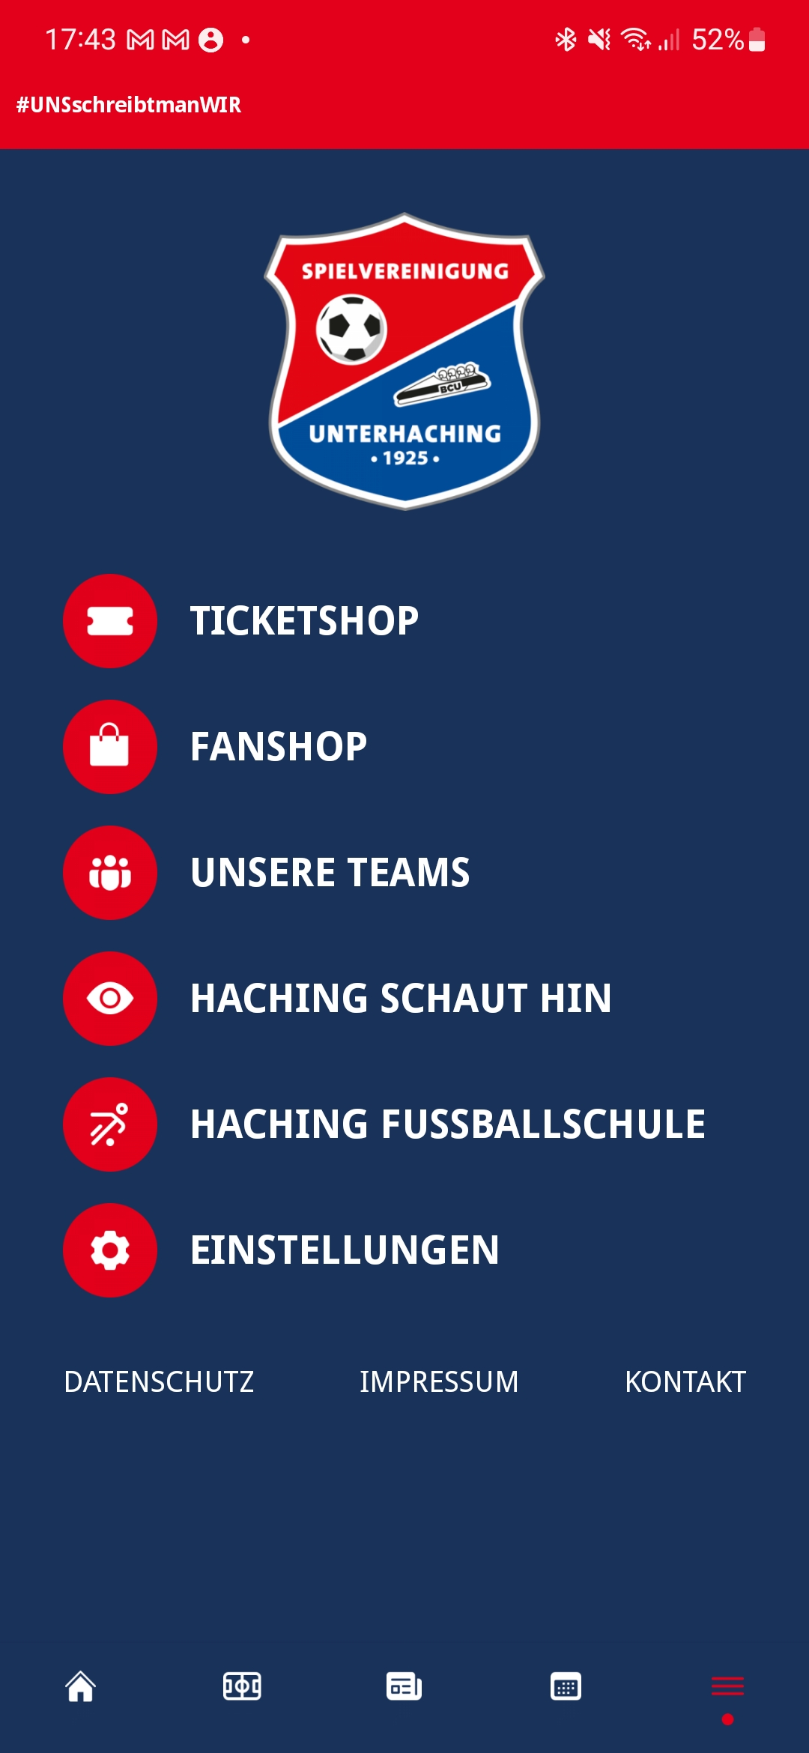
Notes:
In die Runde fragen: Wie ist die Seite aufgebaut

Slide 70
App
stateless
Scaffold
stateless
AppBar
stateless
Column
stateless
BottomNavigationBar
stateful
Text
stateless
Icon
stateless
Image
stateless
Row
stateless
Row
stateless
…
Icon
stateless
Text
stateless
Text
stateless
Text
stateless
Text
stateless

Slide 71
Flutter Basics
What is BuildContext?
Notes:
Wie kann man in diesem Baum navigieren, bzw. die Widgets unterscheiden?

Slide 72
BuildContext
Every widget has a unique BuildContext
A reference or handle to the location of a widget within the widget tree
Allows you to access data or functions from ancestor widgets
Notes:
Imagine you're at a huge family reunion, and you want to find your cousin Bob. You can't just shout "Bob!" because there might be multiple Bobs. So, you'd start by asking the people immediately around you (your "context"), and they might point you in the right direction or to someone else who might know. Eventually, by using this "context" of people around you, you find Bob.
In Flutter, widgets are like family members at this reunion, and the BuildContext is a way to locate a specific widget or obtain information from the widget tree (family tree in our analogy).

Slide 73
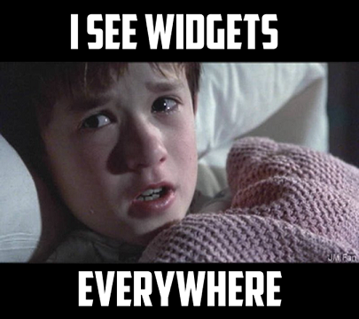
Summary
”Everything is a widget”
A page is just a tree of widgets (including itself)
There are stateless & stateful widgets
Use BuildContext to navigate the tree

Slide 74

Dart Crash-Course

Slide 75
Built-in types

Slide 76
Built-in types
int integer = 42;

Slide 77
Built-in types
int integer = 42;
String string = 'This is a string';

Slide 78
Built-in types
int integer = 42;
String string = 'This is a string';
bool boolean = true || false;

Slide 79
Built-in types
int integer = 42;
String string = 'This is a string';
bool boolean = true || false;
double d = 3.1415;

Slide 80
Built-in types
int integer = 42;
String string = 'This is a string';
bool boolean = true || false;
double d = 3.1415;
List<int> numbers = [1, 2, 3, 4, 5];

Slide 81
Further built-in types
Record/Tuple
Set
Map
Null
Object (Everything except for Null)
Void

Slide 82
Null safety

Slide 83
Null safety
int number = null;

Slide 84
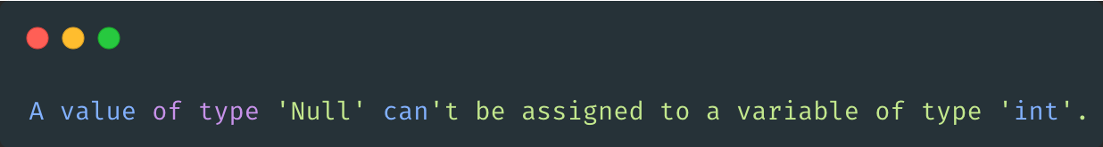
Null safety
int number = null;

Slide 85
Null safety
int? number = null;
👆 Nullable type
Notes:
Sound!!!

Slide 86
Control flow

Slide 87
Control flow (conditional branching)
if (condition) { // do something } else if (anotherCondition) { // do something else } else { // do something else }

Slide 88
Control flow (while loop)
while (!isDone()) { doSomething(); }

Slide 89
Functions
bool isDone() { return true; }
while (!isDone()) { doSomething(); }

Slide 90
Functions
void doSomething() { print('Hello World!'); }
bool isDone() { return true; }
while (!isDone()) { doSomething(); }

Slide 91
Functions
bool isDone(int number) { return number == 3; }
int number = 0; while(!isDone(number)) { doSomething(); number++; }

Slide 92
Anonymous functions
void doSomething( void Function(int count) something, int count, ) { something(count); }
doSomething((count) { print('Hello World! $count'); }, number);

Slide 93
Anonymous functions
void doSomething( void Function(int count) something, int count, ) { something(count); }
doSomething((count) { print('Hello World! $count'); }, number);
👈 Functions are also objects

Slide 94
Control flow (for loop)
var message = StringBuffer('Dart is fun'); for (var i = 0; i < 5; i++) { message.write('!'); }

Slide 95
Control flow (enhanced for loop)
final participants = <Participant>[]; for (final participant in participants) { print('Hallo ${participant.name}!'); }

Slide 96
Classes
class Participant { final String name; Participant(this.name); }
👆 Positional parameter

Slide 97
Classes
class Participant { final String name; const Participant(this.name); }
👆 All members can be known at compile time

Slide 98
Classes
class Participant { final String name; final int age; const Participant(this.age, { required this.name, }); }
👆 Required named parameter

Slide 99
Classes
class Participant { final String name; final int age; final String role; const Participant( this.age, { required this.name, this.role = 'member', }); }
👆 Optional named parameter with default value

Slide 100
Classes
class Participant { final String name; final int age; final String role; final String _password; const Participant( this.age, { required this.name, this.role = 'member', required String password, }) : _password = password; }
👈 Private member

Slide 101
Classes
class Participant { final String name; final int age; final String role; final String _password; const Participant( this.age, { required this.name, this.role = 'member', required String password, }) : _password = password; }
👈 Private member
👆 Initializer

Slide 102
Classes
class Participant { final String name; final int age; final String role; final String _password; const Participant( this.age, { required this.name, this.role = 'member', required String password, }) : _password = password; void greet() { print('Hello $name!'); } }
👈 Instance method

Slide 103
Classes
class Participant { final String name; final int age; final String role; final String _password; const Participant( this.age, { required this.name, this.role = 'member', required String password, }) : _password = password; bool get hasFun => true;
}
👈 Getter

Slide 104
Classes
class Participant { ... String _password; Participant( this.age, { required this.name, this.role = 'member', required String password, }) : _password = password; set password(String newPassword) { if (newPassword.length < 8) { throw Exception('Password must be at least 8 characters long'); } _password = newPassword; } }
👈 Setter

Slide 105
Classes
class Participant { final String name; final int age; final String role; String _password; Participant( this.age, { required this.name, this.role = 'member', required String password, }) : _password = password; void greet() { print('Hello $name!'); } bool get hasFun => true; set password(String newPassword) { if (newPassword.length < 8) { throw Exception('Password must be at least 8 characters long'); } _password = newPassword; } }

Slide 106
Classes
final participant = Participant( 19, name: 'Julian Hartl', password: 'mysecretpassword', );

Slide 107
Classes
final participant = Participant( 19, name: 'Julian Hartl', password: 'mysecretpassword', );
Positional parameter 👉

Slide 108
Classes
final participant = Participant( 19, name: 'Julian Hartl', password: 'mysecretpassword', );
Positional parameter 👉
👈 Named parameters

Slide 109
Classes
final participant = Participant( 19, name: 'Julian Hartl', password: 'mysecretpassword', ); participant.greet();
Positional parameter 👉
👈 Named parameters
👈 Call the greet method

Slide 110
Classes
final participant = Participant( 19, name: 'Julian Hartl', password: 'mysecretpassword', ); participant.greet();
particpant.password = 'myverysecretpassword';
Positional parameter 👉
👈 Named parameters
👈 Call the greet method
Set new password 👉

Slide 111
Classes
final participant = Participant( 19, name: 'Julian Hartl', password: 'mysecretpassword', ); participant.greet();
particpant.password = 'myverysecretpassword‘;
print(particpant.hasFun);
Positional parameter 👉
👈 Named parameters
👈 Call the greet method
Set new password 👉
👈 Use hasFun getter

Slide 112
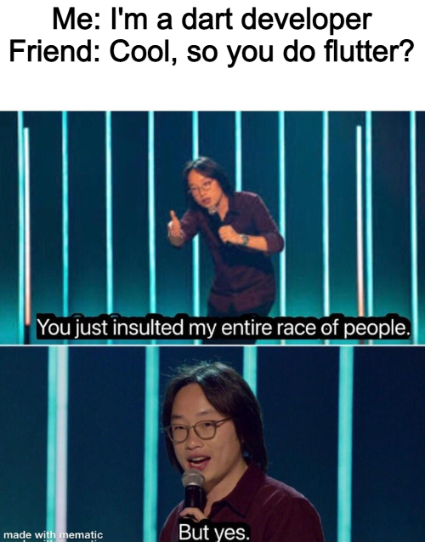
Summary
Very Java/JavaScript like language
Easy to pick up
Lots of modern features

Slide 113
Shopping List App
Notes:
iPad herumgeben!!!

Slide 114
Demo
Shopping List App
Notes:
iPad herumgeben!!!

Slide 115
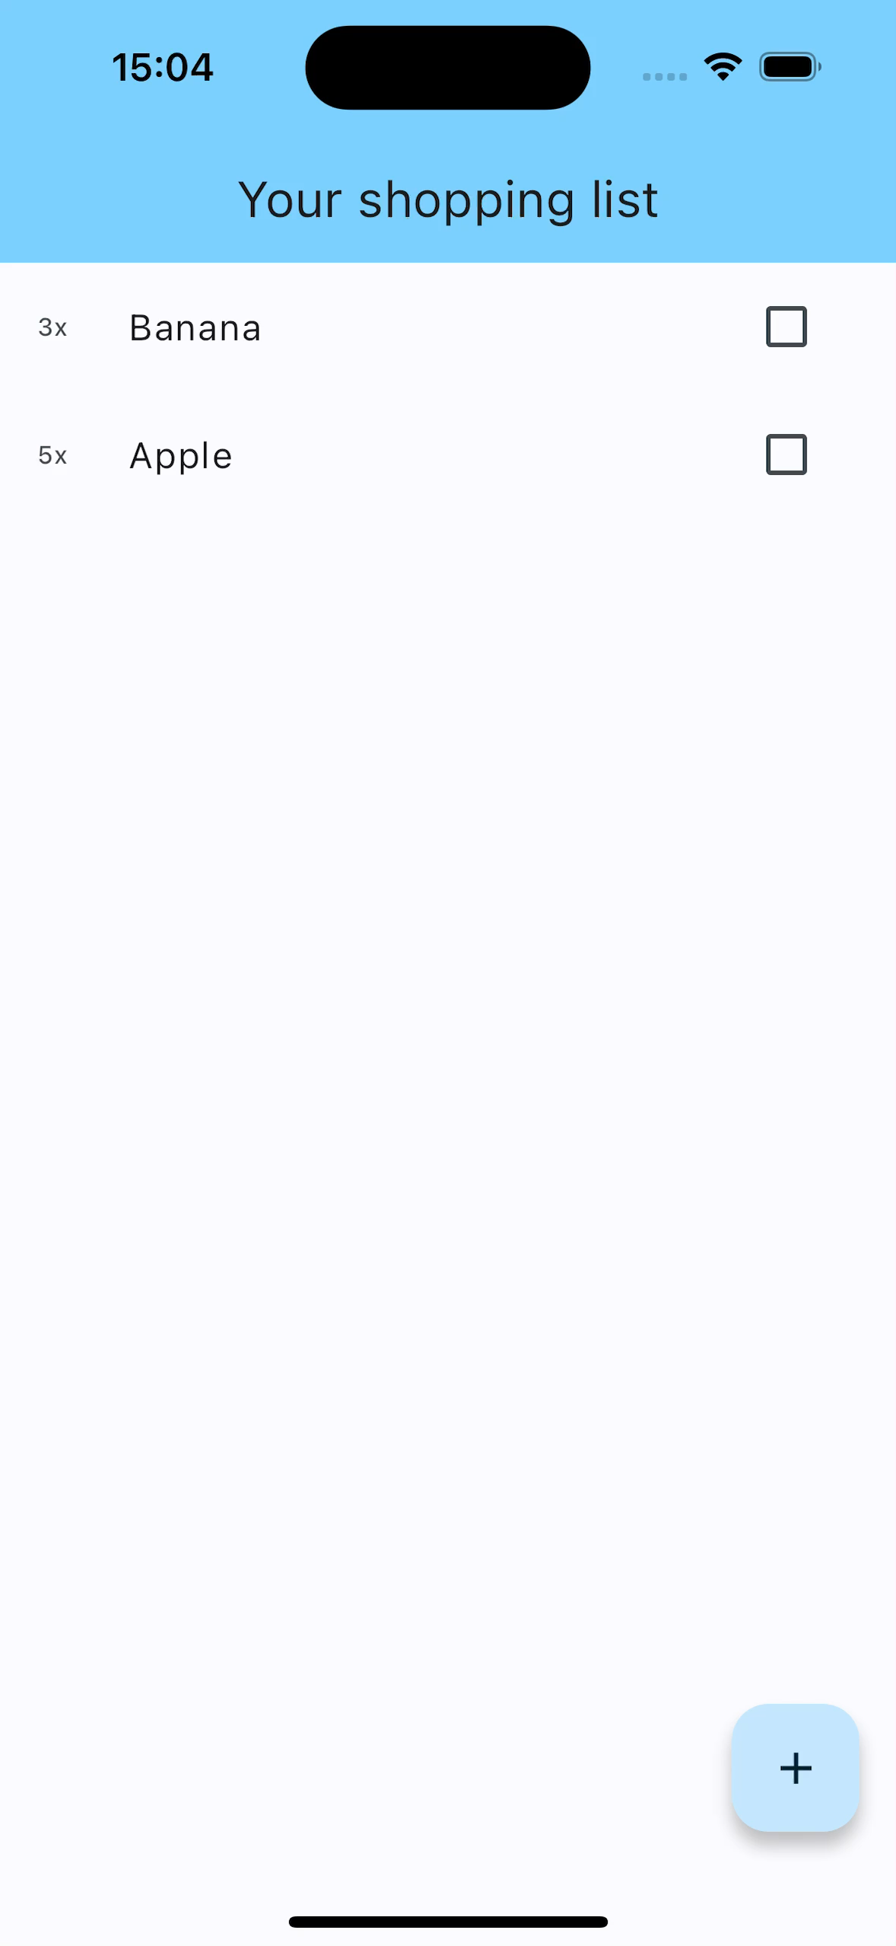

Slide 116
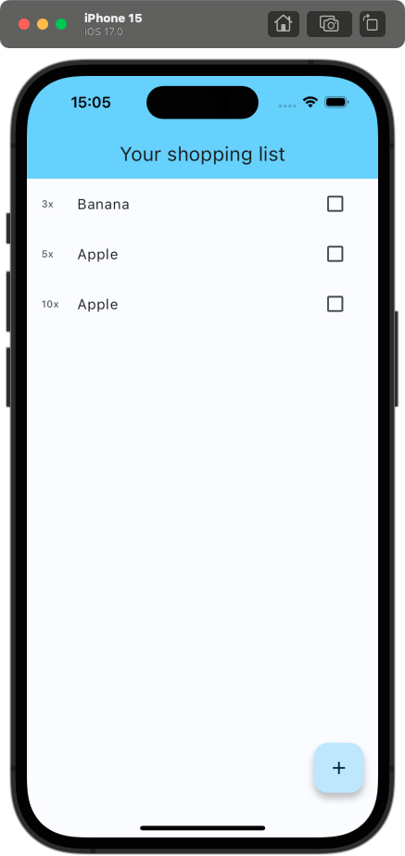
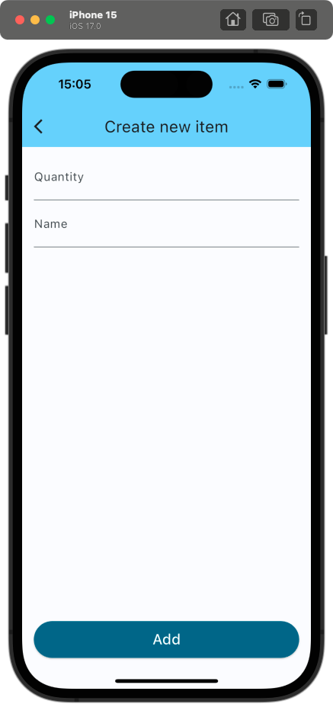

Slide 118
“Live”-Coding
Shopping List App

Slide 119


Slide 121
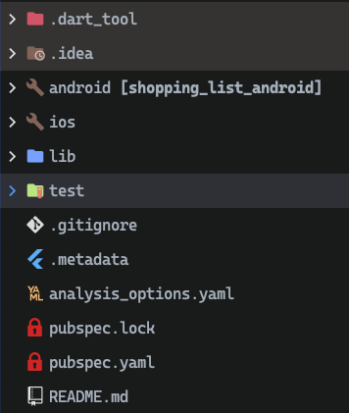

Slide 122
👈 “The .dart_tool directory, which is new in Dart 2, is used by pub and other tools.“
👈 Code specific to the operating systems
👈 Actual Flutter related code
👈 Here go your tests 😜
👈 Linter configuration
👈 Dependencies lock file (similar to yarn.lock or package-json.lock)
👈 Dependencies, assets, project configuration

Slide 123
pubspec.yaml
Project configuration

Slide 124

name: shopping_list description: A new Flutter project. publish_to: 'none' version: 1.0.0+1 environment: sdk: '>=3.1.3 <4.0.0' dependencies: flutter: sdk: flutter cupertino_icons: ^1.0.2 dev_dependencies: flutter_test: sdk: flutter flutter_lints: ^2.0.0

Slide 125
name: shopping_list description: A new Flutter project. publish_to: 'none' version: 1.0.0+1 environment: sdk: '>=3.1.3 <4.0.0' dependencies: flutter: sdk: flutter cupertino_icons: ^1.0.2 dev_dependencies: flutter_test: sdk: flutter flutter_lints: ^2.0.0
👈 Project configuration

Slide 126
name: shopping_list description: A new Flutter project. publish_to: 'none' version: 1.0.0+1 environment: sdk: '>=3.1.3 <4.0.0' dependencies: flutter: sdk: flutter cupertino_icons: ^1.0.2 dev_dependencies: flutter_test: sdk: flutter flutter_lints: ^2.0.0
👈 Project configuration
👈 Version + build number

Slide 127
name: shopping_list description: A new Flutter project. publish_to: 'none' version: 1.0.0+1 environment: sdk: '>=3.1.3 <4.0.0' dependencies: flutter: sdk: flutter cupertino_icons: ^1.0.2 dev_dependencies: flutter_test: sdk: flutter flutter_lints: ^2.0.0
👈 Project configuration
👈 Version + build number
👈 Supported dart versions

Slide 128
name: shopping_list description: A new Flutter project. publish_to: 'none' version: 1.0.0+1 environment: sdk: '>=3.1.3 <4.0.0' dependencies: flutter: sdk: flutter cupertino_icons: ^1.0.2 dev_dependencies: flutter_test: sdk: flutter flutter_lints: ^2.0.0
👈 Project configuration
👈 Version + build number
👈 Supported dart versions
👈 Any packages which are included in the bundled app

Slide 129
name: shopping_list description: A new Flutter project. publish_to: 'none' version: 1.0.0+1 environment: sdk: '>=3.1.3 <4.0.0' dependencies: flutter: sdk: flutter cupertino_icons: ^1.0.2 dev_dependencies: flutter_test: sdk: flutter flutter_lints: ^2.0.0
👈 Project configuration
👈 Version + build number
👈 Supported dart versions
👈 Any packages which are included in the bundled app
👈 Any packages that are needed during development, but should not be bundled in the final app

Slide 130
flutter: uses-material-design: true assets: - images/a_dot_burr.jpeg - images/a_dot_ham.jpeg fonts: - family: Schyler fonts: - asset: fonts/Schyler-Regular.ttf - asset: fonts/Schyler-Italic.ttf style: italic - family: Trajan Pro fonts: - asset: fonts/TrajanPro.ttf - asset: fonts/TrajanPro_Bold.ttf weight: 700
Notes:
Konfigurationen die mit Flutter zu tun haben

Slide 131
flutter: uses-material-design: true assets: - images/a_dot_burr.jpeg - images/a_dot_ham.jpeg fonts: - family: Schyler fonts: - asset: fonts/Schyler-Regular.ttf - asset: fonts/Schyler-Italic.ttf style: italic - family: Trajan Pro fonts: - asset: fonts/TrajanPro.ttf - asset: fonts/TrajanPro_Bold.ttf weight: 700
👈 Any assets, that should be included in the bundled app

Slide 132
flutter: uses-material-design: true assets: - images/a_dot_burr.jpeg - images/a_dot_ham.jpeg fonts: - family: Schyler fonts: - asset: fonts/Schyler-Regular.ttf - asset: fonts/Schyler-Italic.ttf style: italic - family: Trajan Pro fonts: - asset: fonts/TrajanPro.ttf - asset: fonts/TrajanPro_Bold.ttf weight: 700
👈 Any assets, that should be included in the bundled app
👈 Definition of customs fonts

Slide 133
Pub
The package manager

Slide 134
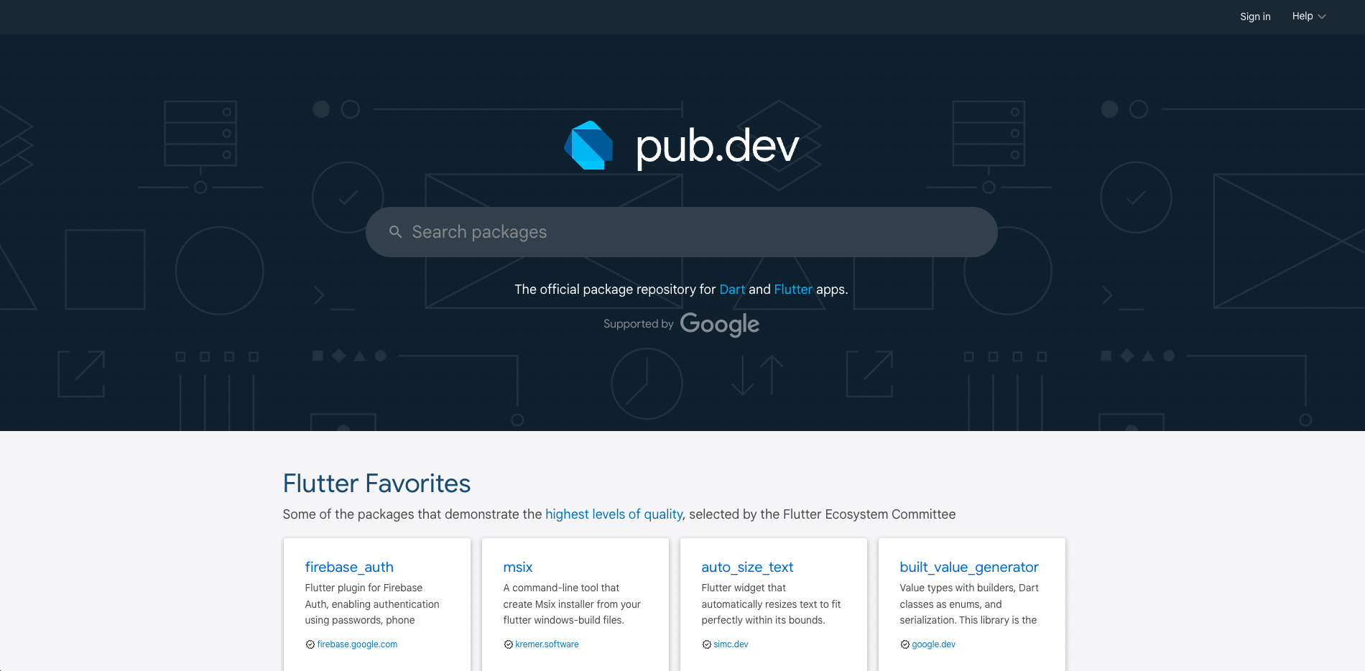
pub.dev

Slide 135
Adding a package
1. Search for a package

Slide 136
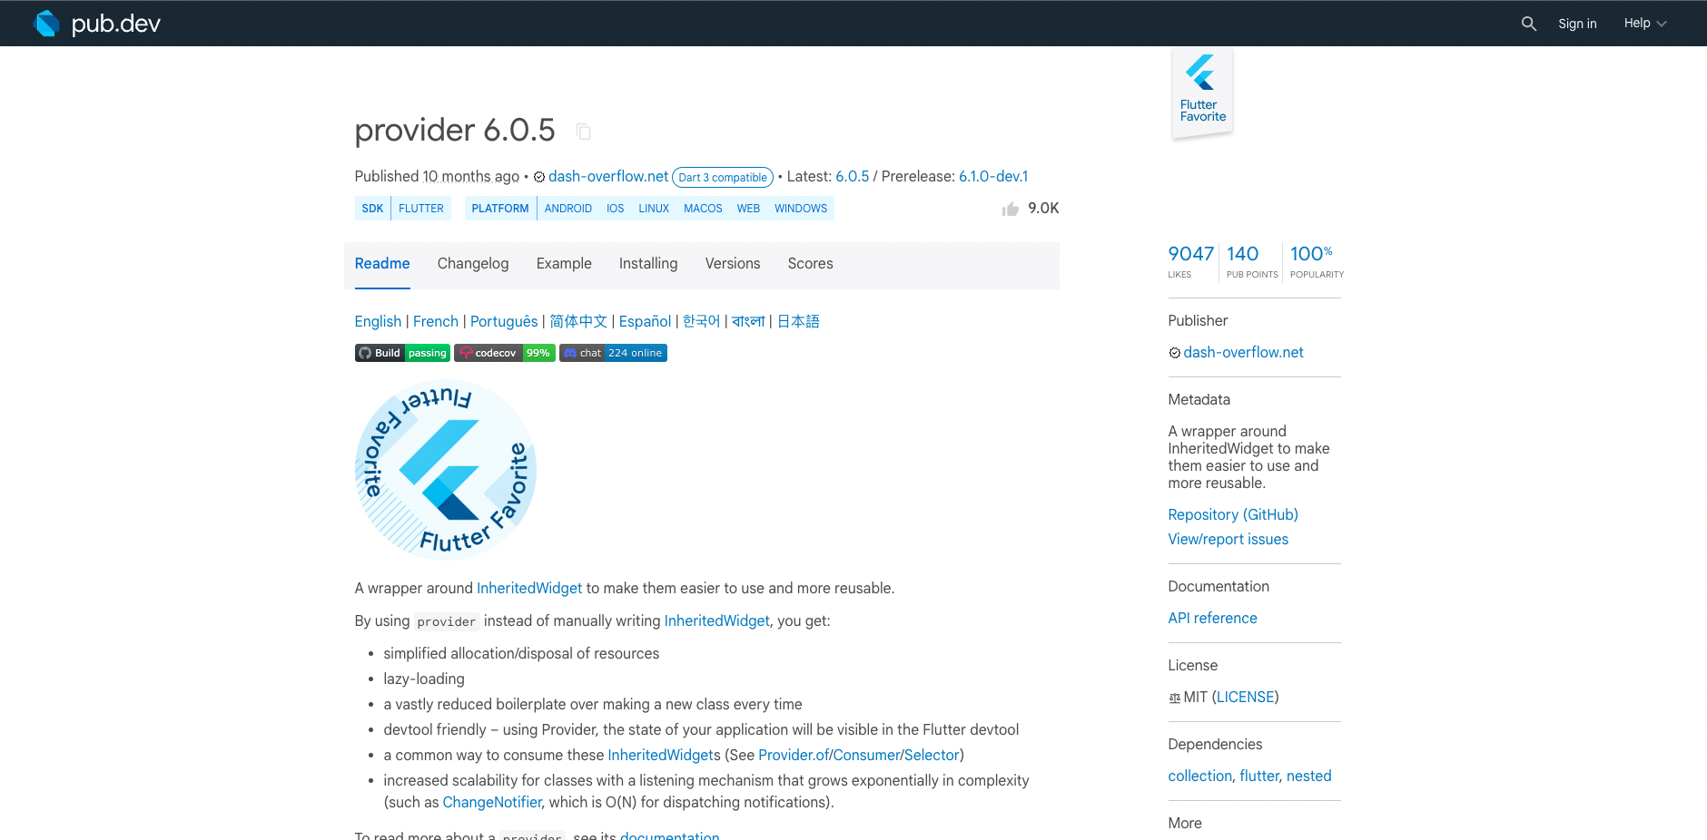
Searching for a package

Slide 137
Adding a package
Search for a package
Add the package to the project

Slide 138
Adding package to project
👈 Click here to copy package: version

Slide 139
Adding package to project
dependencies: flutter: sdk: flutter cupertino_icons: ^1.0.2

Slide 140
Adding package to project
dependencies: flutter: sdk: flutter cupertino_icons: ^1.0.2 provider: ^6.0.5

Slide 141
Adding package to project

Slide 142
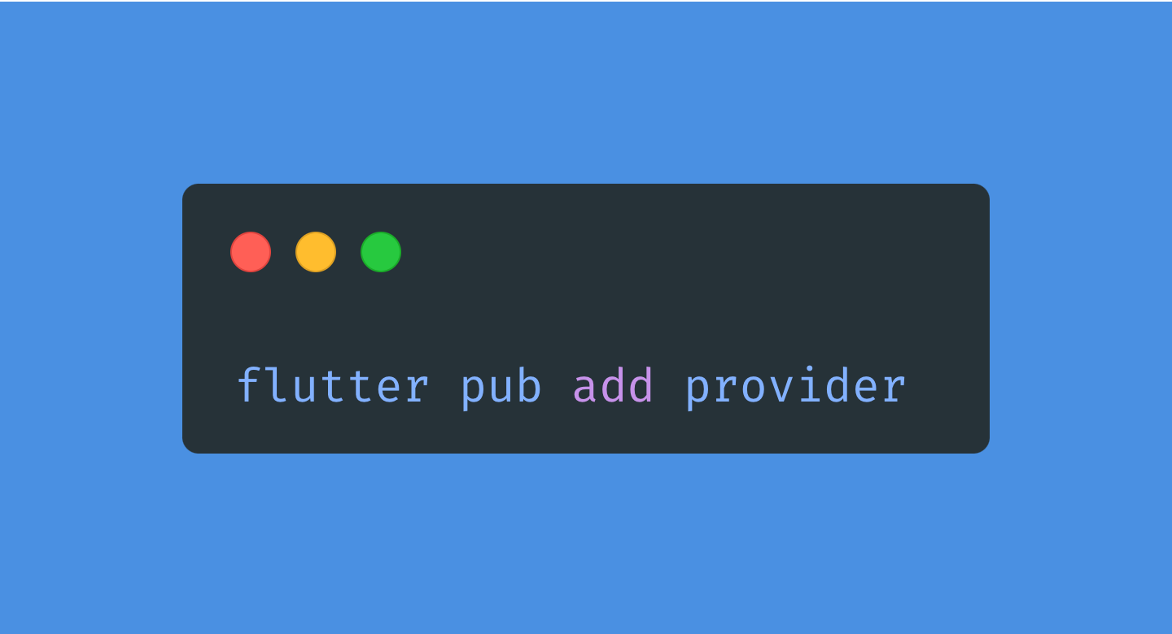
Adding package to project

Slide 143
Adding a package
Search for a package
Add the package to the project
Resolve & fetch dependencies

Slide 144
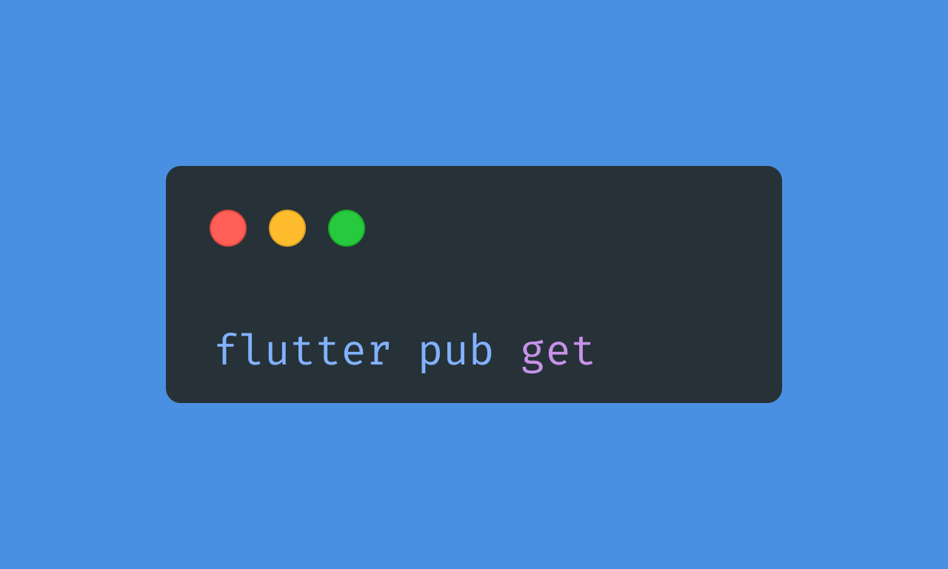
Resolving & fetching dependencies

Slide 145
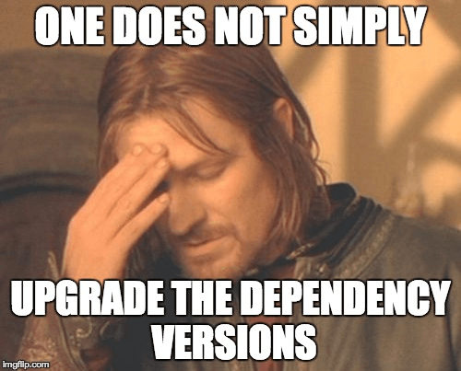

Slide 146
Getting Started
Shopping List App

Slide 147
import 'package:flutter/material.dart'; void main() { runApp(const MyApp()); } class MyApp extends StatelessWidget { const MyApp({super.key}); @override Widget build(BuildContext context) { return MaterialApp( title: 'Flutter Demo', theme: ThemeData( colorScheme: ColorScheme.fromSeed(seedColor: Colors.deepPurple), useMaterial3: true, ), home: const MyHomePage(title: 'Flutter Demo Home Page'), ); } }

Slide 148
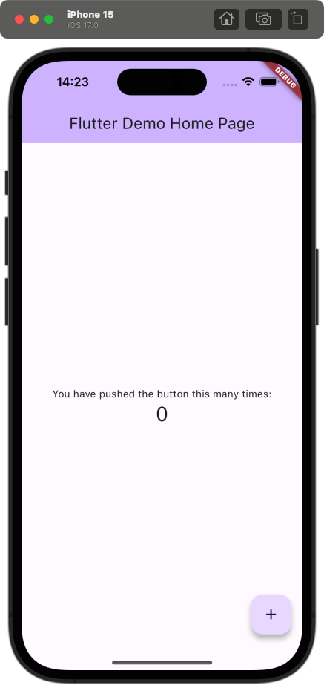
import 'package:flutter/material.dart'; void main() { runApp(const MyApp()); } class MyApp extends StatelessWidget { const MyApp({super.key}); @override Widget build(BuildContext context) { return MaterialApp( title: 'Flutter Demo', theme: ThemeData( colorScheme: ColorScheme.fromSeed(seedColor: Colors.deepPurple), useMaterial3: true, ), home: const MyHomePage(title: 'Flutter Demo Home Page'), ); } }

Slide 149
import 'package:flutter/material.dart'; void main() { runApp(const MyApp()); } class MyApp extends StatelessWidget { const MyApp({super.key}); @override Widget build(BuildContext context) { return MaterialApp( title: 'Flutter Demo', theme: ThemeData( colorScheme: ColorScheme.fromSeed(seedColor: Colors.deepPurple), useMaterial3: true, ), home: const MyHomePage(title: 'Flutter Demo Home Page'), ); } }

Slide 150
import 'package:flutter/material.dart'; void main() { runApp(const MyApp()); } class MyApp extends StatelessWidget { const MyApp({super.key}); @override Widget build(BuildContext context) { return MaterialApp( title: 'Flutter Demo', theme: ThemeData( colorScheme: ColorScheme.fromSeed(seedColor: Colors.deepPurple), useMaterial3: true, ), home: const MyHomePage(title: 'Flutter Demo Home Page'), ); } }
👈 Gives access to prebuilt widgets according to Material-UI Guidelines

Slide 151
import 'package:flutter/material.dart'; void main() { runApp(const MyApp()); } class MyApp extends StatelessWidget { const MyApp({super.key}); @override Widget build(BuildContext context) { return MaterialApp( title: 'Flutter Demo', theme: ThemeData( colorScheme: ColorScheme.fromSeed(seedColor: Colors.deepPurple), useMaterial3: true, ), home: const MyHomePage(title: 'Flutter Demo Home Page'), ); } }
👈 Gives access to prebuilt widgets according to Material-UI Guidelines
👈 Entry point of the application

Slide 152
import 'package:flutter/material.dart'; void main() { runApp(const MyApp()); } class MyApp extends StatelessWidget { const MyApp({super.key}); @override Widget build(BuildContext context) { return MaterialApp( title: 'Flutter Demo', theme: ThemeData( colorScheme: ColorScheme.fromSeed(seedColor: Colors.deepPurple), useMaterial3: true, ), home: const MyHomePage(title: 'Flutter Demo Home Page'), ); } }
👈 Gives access to prebuilt widgets according to Material-UI Guidelines
👈 Entry point of the application
👈 Extending from StatelessWidget to define a stateless widget

Slide 153
import 'package:flutter/material.dart'; void main() { runApp(const MyApp()); } class MyApp extends StatelessWidget { const MyApp({super.key}); @override Widget build(BuildContext context) { return MaterialApp( title: 'Flutter Demo', theme: ThemeData( colorScheme: ColorScheme.fromSeed(seedColor: Colors.deepPurple), useMaterial3: true, ), home: const MyHomePage(title: 'Flutter Demo Home Page'), ); } }
👈 Gives access to prebuilt widgets according to Material-UI Guidelines
👈 Entry point of the application
👈 Extending from StatelessWidget to define a stateless widget
👈 What is this?

Slide 154

MaterialApp
“A convenience widget that wraps a number of widgets that are commonly required for Material Design applications. It builds upon a WidgetsApp by adding material-design specific functionality […]“

Slide 155
Types of apps
MaterialApp
CupertinoApp
WidgetsApp
Provides styles to material widgets according to the Material design language for iOS, Android and web
Most commonly used
Provides styles to cupertino widgets based on Apple‘s Human Interface Guidelines
Used to build standard iOS-styled apps
Basis for the other two apps
Rarely to never used by actual Flutter developers

Slide 156
class MyApp extends StatelessWidget { const MyApp({super.key}); @override Widget build(BuildContext context) { return MaterialApp( title: 'Flutter Demo', theme: ThemeData( colorScheme: ColorScheme.fromSeed(seedColor: Colors.deepPurple), useMaterial3: true, ), home: const MyHomePage(title: 'Flutter Demo Home Page'), ); } }

Slide 157
class MyApp extends StatelessWidget { const MyApp({super.key}); @override Widget build(BuildContext context) { return MaterialApp( title: 'Flutter Demo', theme: ThemeData( colorScheme: ColorScheme.fromSeed(seedColor: Colors.deepPurple), useMaterial3: true, ), home: const MyHomePage(title: 'Flutter Demo Home Page'), ); } }
👈 Defines the theme of the application

Slide 158
class MyApp extends StatelessWidget { const MyApp({super.key}); @override Widget build(BuildContext context) { return MaterialApp( title: 'Flutter Demo', theme: ThemeData( colorScheme: ColorScheme.fromSeed(seedColor: Colors.deepPurple), useMaterial3: true, ), home: const MyHomePage(title: 'Flutter Demo Home Page'), ); } }
👈 Defines the theme of the application
👆Defines the page that is initially rendered

Slide 159
class MyApp extends StatelessWidget { const MyApp({super.key}); @override Widget build(BuildContext context) { return MaterialApp( title: 'Flutter Demo', theme: ThemeData( colorScheme: ColorScheme.fromSeed( seedColor: const Color( 0xff38bdf8, ), ), useMaterial3: true, ), home: const MyHomePage(title: 'Flutter Demo Home Page'), ); } }
👈 Custom hex color prefixed with 0xff

Slide 160
class MyApp extends StatelessWidget { const MyApp({super.key}); @override Widget build(BuildContext context) { return MaterialApp( title: 'Shopping list', theme: ThemeData( colorScheme: ColorScheme.fromSeed( seedColor: const Color( 0xff38bdf8, ), ), useMaterial3: true, ), home: const MyHomePage(title: 'Your shopping list'), ); } }

Slide 161
How do I run the app?
Using the flutter cli

Slide 162
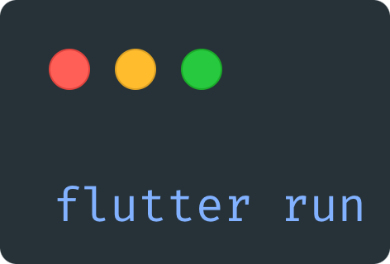
Running the app
Looks for any connected device (simulators, physical devices, …)
When started, type “r“ to hot reload and “R“ to hot restart

Slide 163
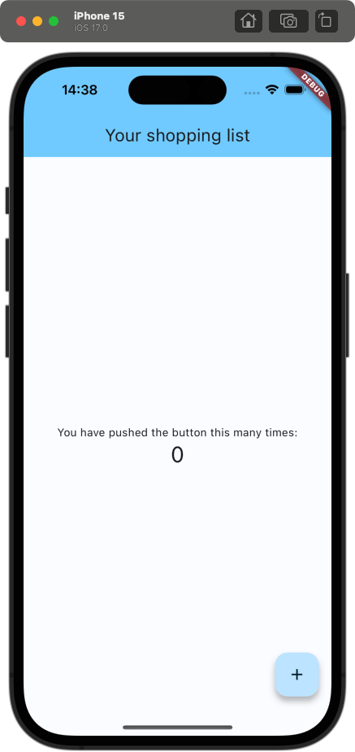
lib/main.dart
class MyApp extends StatelessWidget { const MyApp({super.key}); @override Widget build(BuildContext context) { return MaterialApp( title: 'Shopping list', theme: ThemeData( colorScheme: ColorScheme.fromSeed( seedColor: const Color( 0xff38bdf8, ), ), useMaterial3: true, ), home: const MyHomePage(title: 'Your shopping list'), ); } }

Slide 164
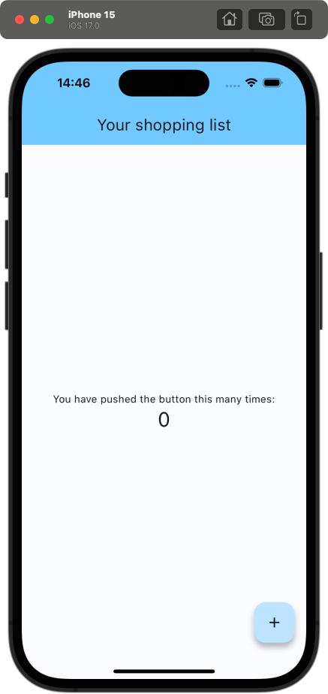
lib/main.dart
class MyApp extends StatelessWidget { const MyApp({super.key}); @override Widget build(BuildContext context) { return MaterialApp( title: 'Shopping list', debugShowCheckedModeBanner: false, theme: ThemeData( colorScheme: ColorScheme.fromSeed( seedColor: const Color( 0xff38bdf8, ), ), useMaterial3: true, ), home: const MyHomePage(title: 'Your shopping list'), ); } }
👆 Hide DEBUG banner

Slide 165
Shopping list app
Creating the first page

Slide 167
lib/main.dart
class MyHomePage extends StatelessWidget { const MyHomePage({super.key}); @override Widget build(BuildContext context) { return const Placeholder(); } }
Notes:
Das sieht ja jetzt erstmal nach recht viel Boilerplate aus => Lösung: Alle IDEs bieten Live-Templates, um diesen Boilerplate zu erstellen

Slide 168
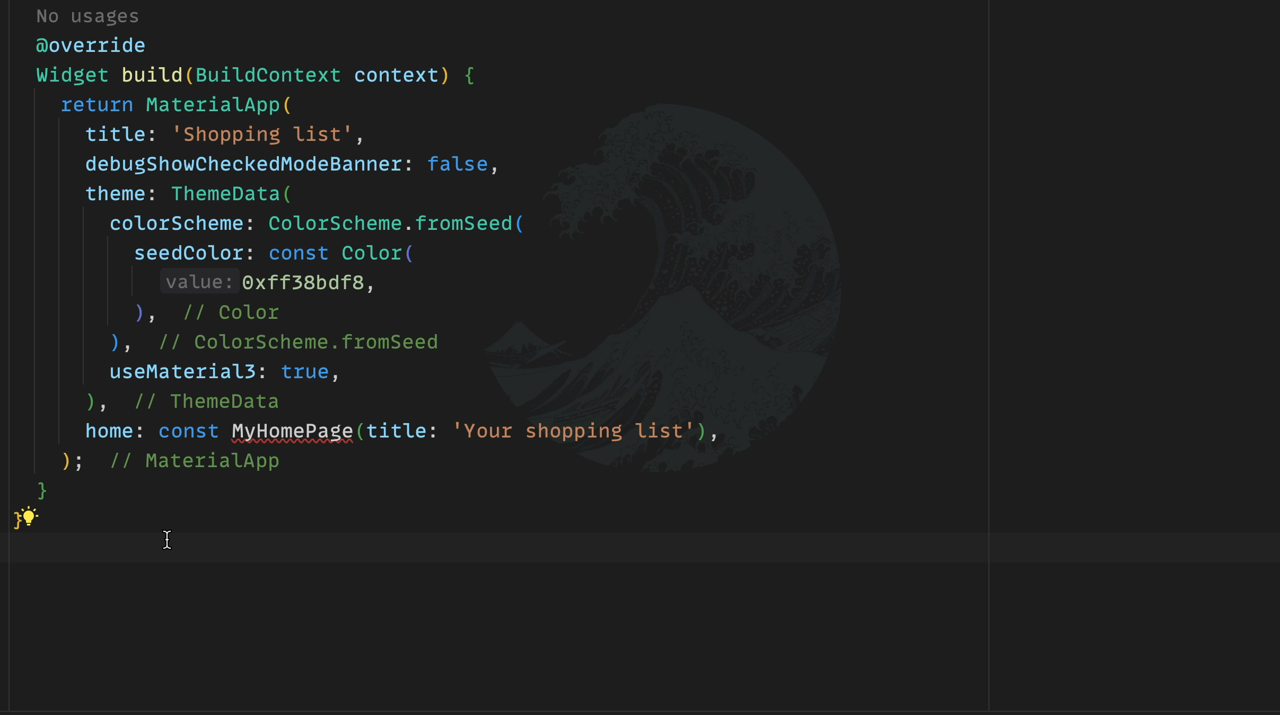
lib/main.dart
class MyHomePage extends StatelessWidget { const MyHomePage({super.key}); @override Widget build(BuildContext context) { return const Placeholder(); } }

Slide 169
lib/main.dart
class MyHomePage extends StatelessWidget { const MyHomePage({super.key}); @override Widget build(BuildContext context) { return const Placeholder(); } }

Slide 170
lib/main.dart
class MyHomePage extends StatelessWidget { const MyHomePage({super.key, required this.title}); final String title; @override Widget build(BuildContext context) { return const Placeholder(); } }

Slide 171
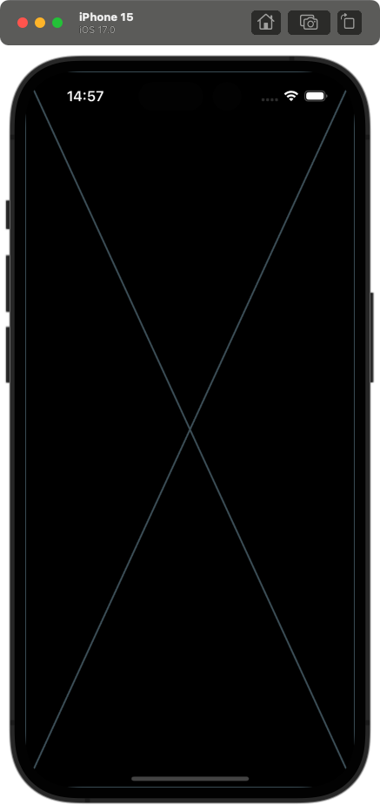
class MyHomePage extends StatelessWidget { const MyHomePage({super.key, required this.title}); final String title; @override Widget build(BuildContext context) { return const Placeholder(); } }
Notes:
Wir brauchen nun ein wenig Struktur (oder eine Art Baugerüst) auf der Seite => Perfekter Startpunkt: Scaffold

Slide 172
Scaffold
“Implements the basic Material Design visual layout structure.“

Slide 173
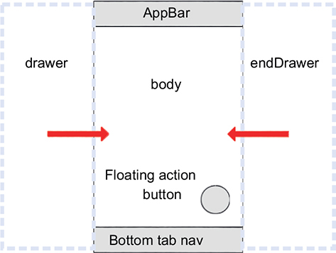
Scaffold
appBar: “An app bar to display at the top of the scaffold.“
body: “The primary content of the scaffold.“
floatingActionButton: “A button displayed floating above body, in the bottom right corner.“
backgroundColor: “The color of the Material widget that underlies the entire scaffold.“
see all properties here
Notes:
backgroundColor wird normalerweise über das Theme in der MaterialApp gesetzt => einheitliches Design

Slide 174
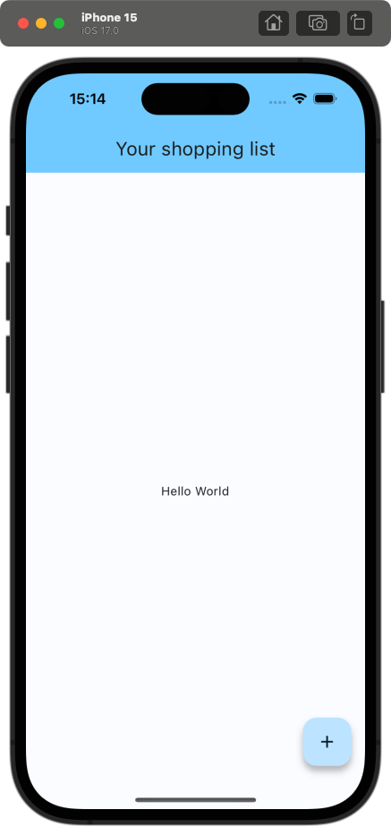
lib/main.dart
class MyHomePage extends StatelessWidget { const MyHomePage({super.key, required this.title}); final String title; @override Widget build(BuildContext context) { return Scaffold( appBar: AppBar( backgroundColor: Theme.of(context).colorScheme.inversePrimary, title: Text(title), ), body: const Center( child: Text('Hello World'), ), floatingActionButton: FloatingActionButton( onPressed: () {}, child: const Icon(Icons.add), ), ); } }

Slide 175
lib/main.dart
class MyHomePage extends StatelessWidget { const MyHomePage({super.key, required this.title}); final String title; @override Widget build(BuildContext context) { return Scaffold( appBar: AppBar( backgroundColor: Theme.of(context).colorScheme.inversePrimary, title: Text(title), ), body: const Center( child: Text('Hello World'), ), floatingActionButton: FloatingActionButton( onPressed: () {}, child: const Icon(Icons.add), ), ); } }

Slide 176
lib/main.dart
class MyHomePage extends StatelessWidget { const MyHomePage({super.key, required this.title}); final String title; @override Widget build(BuildContext context) { return Scaffold( appBar: AppBar( backgroundColor: Theme.of(context).colorScheme.inversePrimary, title: Text(title), ), body: const Center( child: Text('Hello World'), ), floatingActionButton: FloatingActionButton( onPressed: () {}, child: const Icon(Icons.add), ), ); } }

Slide 177
lib/main.dart
class MyHomePage extends StatelessWidget { const MyHomePage({super.key, required this.title}); final String title; @override Widget build(BuildContext context) { return Scaffold( appBar: AppBar( backgroundColor: Theme.of(context).colorScheme.inversePrimary, title: Text(title), ), body: const Center( child: Text('Hello World'), ), floatingActionButton: FloatingActionButton( onPressed: () {}, child: const Icon(Icons.add), ), ); } }

Slide 178
Center
“A widget that centers its child within itself.“

Slide 179

Center
“A widget that centers its child within itself.“
Notes:
Das macht Dinge in Flutter einiges angenehmer als z.B. mit CSS

Slide 180
AppBar
“A Material Design app bar.“

Slide 181
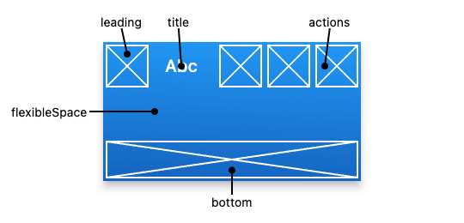
AppBar
title: “The primary widget displayed in the app bar.“
actions: “A list of Widgets to display in a row after the title widget.“
leading: “A widget to display before the toolbar‘s title.“
bottom: “This widget appears across the bottom of the app bar.“
see all properties here

Slide 182
lib/main.dart
class MyHomePage extends StatelessWidget { const MyHomePage({super.key, required this.title}); final String title; @override Widget build(BuildContext context) { return Scaffold( appBar: AppBar( backgroundColor: Theme.of(context).colorScheme.inversePrimary, title: Text(title), ), body: const Center( child: Text('Hello World'), ), floatingActionButton: FloatingActionButton( onPressed: () {}, child: const Icon(Icons.add), ), ); } }
Notes:
kurzer Moment Pause

Slide 183
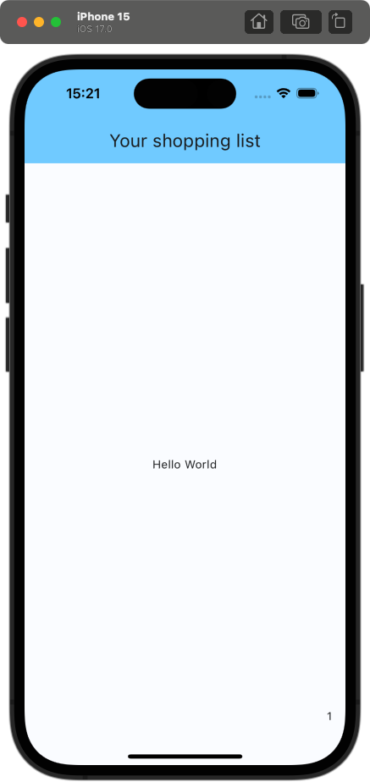
lib/main.dart
@override Widget build(BuildContext context) { return Scaffold( appBar: AppBar( backgroundColor: Theme.of(context).colorScheme.inversePrimary, title: Text(title), ), body: const Center( child: Text('Hello World'), ), floatingActionButton: const Text('1'), ); }
👆floatingActionButton is not of type FloatingActionButton, but Widget
Notes:
Everything is a widget

Slide 184
lib/main.dart
@override Widget build(BuildContext context) { return Scaffold( appBar: AppBar( backgroundColor: Theme.of(context).colorScheme.inversePrimary, title: Text(title), ), body: const Center( child: Text('Hello World'), ), floatingActionButton: FloatingActionButton( onPressed: () {}, child: const Icon(Icons.add), ), ); }

Slide 185
Shopping list app
Defining the models

Slide 186
lib/main.dart
class ShoppingList { final List<ShoppingListItem> items; ShoppingList() : items = []; }

Slide 187
lib/main.dart
class ShoppingList { final List<ShoppingListItem> items; ShoppingList() : items = []; } class ShoppingListItem { final int id; final String name; final int quantity; bool isBought; ShoppingListItem({ required this.id, required this.name, required this.quantity, required this.isBought, }); }

Slide 188
lib/main.dart
class ShoppingList { final List<ShoppingListItem> items; static int _nextId = 0; ShoppingList() : items = []; void addItem({ required String name, required int quantity, }) { items.add( ShoppingListItem( id: _nextId++, name: name, quantity: quantity, isBought: false, ), ); } }

Slide 189
List of ShoppingListItems
Shopping List App

Slide 190
lib/main.dart
class ShoppingListView extends StatefulWidget { const ShoppingListView({super.key}); @override State<ShoppingListView> createState() => _ShoppingListViewState(); } class _ShoppingListViewState extends State<ShoppingListView> { @override Widget build(BuildContext context) { return const Placeholder(); } }
Notes:
So erstellt man ein StatefulWidget => auch hier gibt es ein Live-Template: anstatt stateless aber stful

Slide 191
lib/main.dart
class _ShoppingListViewState extends State<ShoppingListView> { ShoppingList _shoppingList = ShoppingList(); @override Widget build(BuildContext context) { return const Placeholder(); } }
Notes:
Wir wollen nun alle Items aus der ShoppingList anzeigen => wir brauchen einen Scrollable Container, da wir eine dynamische Anzahl an Items haben

Slide 192
ListView
“A scrollable list of widgets arranged linearly.“

Slide 193
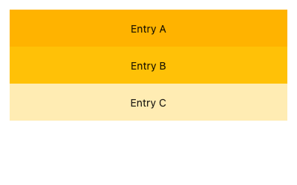
ListView
children: The widgets layed out along the main axis.
scrollDirection: “The axis along which the scroll view‘s offset increases.“
shrinkWrap: “Whether the extent of the scroll view in the scrollDirection should be determined by the contents being viewed.“
controller: “An object that can be used to control the position to which this scroll view is scrolled.“
see all properties here

Slide 194
lib/main.dart
class _ShoppingListViewState extends State<ShoppingListView> { ShoppingList _shoppingList = ShoppingList(); @override Widget build(BuildContext context) { return ListView( children: [], ); } }

Slide 195
lib/main.dart
class _ShoppingListViewState extends State<ShoppingListView> { ShoppingList _shoppingList = ShoppingList(); @override Widget build(BuildContext context) { return ListView( children: [ for (final item in _shoppingList.items) ListTile( leading: Text(item.id.toString()), title: Text(item.name), ) ], ); } }

Slide 196
ListTile
“A single fixed-height row that typically contains some text as well as a leading or trailing icon.“

Slide 197
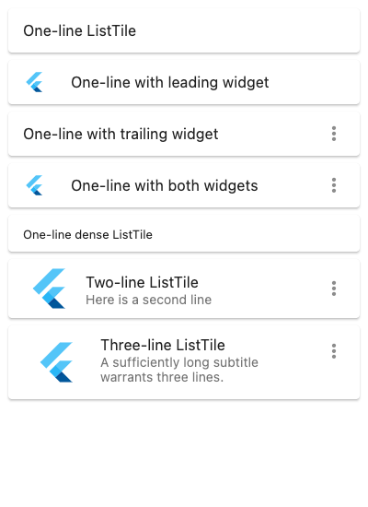
ListTile
title: “The primary content of the list tile.“
leading: “A widget to display before the title.“
trailing: “A widget to display after the title.“
subtitle: “Additional content displayed below the title.“
onTap: “Called when the user taps this list tile.“
see all properties here
Notes:
onTap aktiviert außerdem den Splash Effekt, wenn der Nutzer auf das Tile klickt

Slide 198
lib/main.dart
class _ShoppingListViewState extends State<ShoppingListView> { ShoppingList _shoppingList = ShoppingList(); @override Widget build(BuildContext context) { return ListView( children: [ for (final item in _shoppingList.items) ListTile( leading: Text(item.id.toString()), title: Text(item.name), ) ], ); } }

Slide 199

lib/main.dart
class MyHomePage extends StatelessWidget { const MyHomePage({super.key, required this.title}); final String title; @override Widget build(BuildContext context) { return Scaffold( appBar: AppBar(
backgroundColor:
Theme.of(context).colorScheme.inversePrimary, title: Text(title), ), body: const ShoppingListView(), floatingActionButton: FloatingActionButton( onPressed: () {}, child: const Icon(Icons.add), ), ); } }

Slide 200

lib/main.dart
class _ShoppingListViewState extends State<ShoppingListView> { ShoppingList _shoppingList = ShoppingList() ..addItem( name: 'Banana', quantity: 3, ); @override Widget build(BuildContext context) { return ListView( children: [ for (final item in _shoppingList.items) ListTile( leading: Text(item.id.toString()), title: Text(item.name), ) ], ); } }

Slide 201
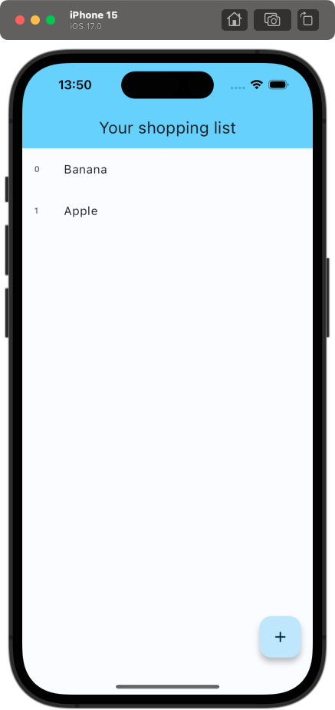
lib/main.dart
class _ShoppingListViewState extends State<ShoppingListView> { ShoppingList _shoppingList = ShoppingList() ..addItem( name: 'Banana', quantity: 3, )
..addItem( name: 'Apple‘, quantity: 5); @override Widget build(BuildContext context) { return ListView( children: [ for (final item in _shoppingList.items) ListTile( leading: Text(item.id.toString()), title: Text(item.name), ) ], ); } }

Slide 202
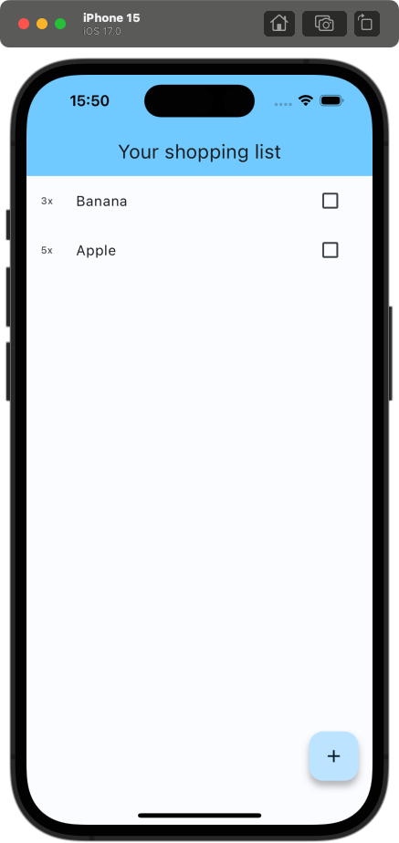
lib/main.dart
@override Widget build(BuildContext context) { return ListView( children: [ for (final item in _shoppingList.items) ListTile( leading: Text('${item.quantity}x'), title: Text(item.name), trailing: Checkbox( value: false, onChanged: (value) {}, ), ) ], ); }
Notes:
Checkbox hinzufügen und quantity anzeigen

Slide 203
CheckBox
“A Material Design checkbox.“

Slide 204
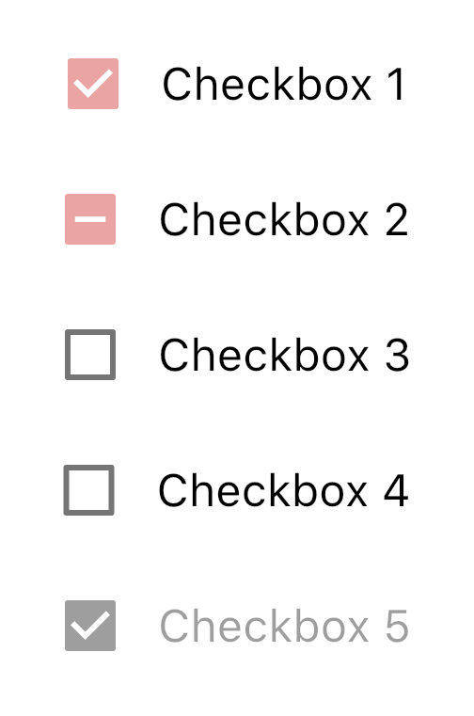
CheckBox
value: “Whether this checkbox is checked.“
onChanged: “Called when the value of the checkbox should change.“
see all properties here

Slide 205
lib/main.dart
@override Widget build(BuildContext context) { return ListView( children: [ for (final item in _shoppingList.items) ListTile( leading: Text('${item.quantity}x'), title: Text(item.name), trailing: Checkbox( value: false, onChanged: (value) {}, ), ) ], ); }

Slide 206
lib/main.dart
@override Widget build(BuildContext context) { return ListView( children: [ for (final item in _shoppingList.items) ListTile( leading: Text('${item.quantity}x'), title: Text(item.name), trailing: Checkbox( value: item.isBought, onChanged: (value) { item.isBought = value!; }, ), ) ], ); }
Notes:
Wir setzen value auf item.isBought, weil die Checkbox gecheckt sein soll, wenn das Item gekauft wurde. Wir updaten in onChange item.isBought.

Slide 207
lib/main.dart
@override Widget build(BuildContext context) { return ListView( children: [ for (final item in _shoppingList.items) ListTile( leading: Text('${item.quantity}x'), title: Text(item.name), trailing: Checkbox( value: item.isBought, onChanged: (value) { item.isBought = value!; }, ), ) ], ); }
Null assertion operator👆
Notes:
Das „!“ ist der Null assertion operator und castet den Wert zu einem nicht nullable Type => wirft eine Exception, falls der Wert null ist

Slide 208

lib/main.dart
class ShoppingList { void setBought(ShoppingListItem item, {required bool bought}) { for (int index = 0; index < _items.length; index++) { if (_items[index].id == item.id) { _items[index] = _items[index].copyWith(isBought: bought); return; } } }
}
class ShoppingListItem { ShoppingListItem copyWith({bool? isBought}) { return ShoppingListItem( id: id, name: name, quantity: quantity, isBought: isBought ?? this.isBought, ); }
}
Notes:
Warum wird nicht neu gerendert? Muss man eventuell der _shoppingList Variable eine neue Instanz zuweisen, wie z.B. mit useState in React? Nein, man muss setState aufrufen!

Slide 209
Simple State Management
Shopping List App

Slide 210
lib/main.dart
@override Widget build(BuildContext context) { return ListView( children: [ for (final item in _shoppingList.items) ListTile( leading: Text('${item.quantity}x'), title: Text(item.name), trailing: Checkbox( value: item.isBought, onChanged: (value) { item.isBought = value!; }, ), ) ], ); }
Notes:
Das „Problem“ ist, dass Flutter nicht automatisch updated, wenn sich ein State-Object ändert. Anstattdessen müssen wir als Entwickler explizit festlegen, wann wir das Widget neu rendern wollen

Slide 211
lib/main.dart
@override Widget build(BuildContext context) { return ListView( children: [ for (final item in _shoppingList.items) ListTile( leading: Text('${item.quantity}x'), title: Text(item.name), trailing: Checkbox( value: item.isBought, onChanged: (value) { item.isBought = value!; }, ), ) ], ); }
👆We have to tell Flutter that the state changed

Slide 212
lib/main.dart
@override Widget build(BuildContext context) { return ListView( children: [ for (final item in _shoppingList.items) ListTile( leading: Text('${item.quantity}x'), title: Text(item.name), trailing: Checkbox( value: item.isBought, onChanged: (value) { setState(() { item.isBought = value!;
}); }, ), ) ], ); }
👆setState rerenders the whole widget sub tree
Notes:
Wir machen das, indem wir setState benutzen! setState wird bereitgestellt durch die Oberklasse „State“

Slide 213

lib/main.dart
@override Widget build(BuildContext context) { return ListView( children: [ for (final item in _shoppingList.items) ListTile( leading: Text('${item.quantity}x'), title: Text(item.name), trailing: Checkbox( value: item.isBought, onChanged: (value) { setState(() { item.isBought = value!;
}); }, ), ) ], ); }

Slide 214
lib/main.dart
@override Widget build(BuildContext context) { return ListView( children: [ for (final item in _shoppingList.items) ListTile( leading: Text('${item.quantity}x'), title: Text(item.name), trailing: Checkbox( value: item.isBought, onChanged: (value) { setState(() { item.isBought = value!;
}); }, ), ) ], ); }

Slide 215
Toggling the Checkbox with ListTile click
ShoppingListApp
Notes:
Wäre cool, wenn wir bei einem Klick auf das ListTile die CheckBox updaten könnten

Slide 216
lib/main.dart
@override Widget build(BuildContext context) { return ListView( children: [ for (final item in _shoppingList.items) ListTile( leading: Text('${item.quantity}x'), title: Text(item.name), trailing: Checkbox( value: item.isBought, onChanged: (value) { setState(() { item.isBought = value!;
}); }, ), ) ], ); }

Slide 217
lib/main.dart
ListTile( onTap: () { setState(() { item.isBought = !item.isBought; }); }, leading: Text('${item.quantity}x'), title: Text(item.name), trailing: Checkbox( value: item.isBought, onChanged: (value) { setState(() { item.isBought = value!;
}); }, ), )
Notes:
Wir benutzen die onTap Property vom ListTile Widget => allerdings duplizierter Code => extrahieren in eine Helfer-Methode

Slide 218
lib/main.dart
ListTile( onTap: () { setState(() { item.isBought = !item.isBought; }); }, leading: Text('${item.quantity}x'), title: Text(item.name), trailing: Checkbox( value: item.isBought, onChanged: (value) { setState(() { item.isBought = value!;
}); }, ), )
Duplicated code
Notes:
Wir benutzen die onTap Property vom ListTile Widget => allerdings duplizierter Code => extrahieren in eine Helfer-Methode

Slide 219
lib/main.dart
void _toggleBought(ShoppingListItem item) { setState(() { item.isBought = !item.isBought; }); }
Notes:
Diese lebt auch in der State Klasse

Slide 220
lib/main.dart
ListTile( onTap: () { setState(() { item.isBought = !item.isBought; }); }, leading: Text('${item.quantity}x'), title: Text(item.name), trailing: Checkbox( value: item.isBought, onChanged: (value) { setState(() { item.isBought = value!;
}); }, ), )

Slide 221
lib/main.dart
ListTile( onTap: () { _toggleBought(item); }, leading: Text('${item.quantity}x'), title: Text(item.name), trailing: Checkbox( value: item.isBought, onChanged: (_) { _toggleBought(item); }, ), )
Notes:
Benutzen der Helfer-Methode _toggleBought

Slide 222
Current Issues
Shopping List App

Slide 223
lib/main.dart
@override Widget build(BuildContext context) { return ListView( children: [ for (final item in _shoppingList.items) ListTile( onTap: () { _toggleBought(item); }, leading: Text('${item.quantity}x'), title: Text(item.name), trailing: Checkbox( value: item.isBought, onChanged: (_) { _toggleBought(item); }, ), ) ], ); }
Notes:
Aktuell mehrere Probleme:
- Bei jedem Call von _toggleBought werden alle ListTiles neu gerendert => Wir wollen aber nur das spezifische ListTile updaten => State im Tree nach unten ziehen
- Bei vielen Items in der ShoppingList werden alle ListTiles auf einmal gerendert => Nur die ListTiles rendern, die auch in View sind => Lazy Rendering

Slide 224
lib/main.dart
@override Widget build(BuildContext context) { return ListView( children: [ for (final item in _shoppingList.items) ListTile( onTap: () { _toggleBought(item); }, leading: Text('${item.quantity}x'), title: Text(item.name), trailing: Checkbox( value: item.isBought, onChanged: (_) { _toggleBought(item); }, ), ) ], ); }
👆 rerenders the whole widget sub tree
Notes:
Aktuell mehrere Probleme:
- Bei jedem Call von _toggleBought werden alle ListTiles neu gerendert => Wir wollen aber nur das spezifische ListTile updaten => State im Tree nach unten ziehen
- Bei vielen Items in der ShoppingList werden alle ListTiles auf einmal gerendert => Nur die ListTiles rendern, die auch in View sind => Lazy Rendering

Slide 225
lib/main.dart
@override Widget build(BuildContext context) { return ListView( children: [ for (final item in _shoppingList.items) ListTile( onTap: () { _toggleBought(item); }, leading: Text('${item.quantity}x'), title: Text(item.name), trailing: Checkbox( value: item.isBought, onChanged: (_) { _toggleBought(item); }, ), ) ], ); }
👆 renders all items at once
👆 rerenders the whole widget sub tree
Notes:
Aktuell mehrere Probleme:
- Bei jedem Call von _toggleBought werden alle ListTiles neu gerendert => Wir wollen aber nur das spezifische ListTile updaten => State im Tree nach unten ziehen
- Bei vielen Items in der ShoppingList werden alle ListTiles auf einmal gerendert => Nur die ListTiles rendern, die auch in View sind => Lazy Rendering

Slide 226
Why does setState rerender every ListTile?
Shopping List App
Notes:
Wäre cool, wenn wir bei einem Klick auf das ListTile die CheckBox updaten könnten

Slide 227
ShoppingListView
…
ListView
ListTile
ListTile
…
ListTile

Slide 228
ShoppingListView
_shoppingList.items
…
ListView
ListTile
ListTile
…
ListTile

Slide 229
ShoppingListView
_shoppingList.items
setState()
…
ListView
ListTile
ListTile
…
ListTile

Slide 230
ShoppingListView
_shoppingList.items
setState()
…
ListView
ListTile
ListTile
…
ListTile

Slide 231
ShoppingListView
_shoppingList.items
setState()
…
ListView
ListTile
ListTile
…
ListTile

Slide 232
ShoppingListView
_shoppingList.items
setState()
…
ListView
ListTile
ListTile
…
ListTile

Slide 233
Lowering state
Shopping List App

Slide 234
ShoppingListView
_shoppingList.items
…
ListView
ListTile
ListTile
…
ListTile
Notes:
Anstatt, dass die items in der ShoppingListView selbst leben, …

Slide 235
ShoppingListView
…
ListView
_ShoppingListItemTile
item
_ShoppingListItemTile
item
_ShoppingListItemTile
item
Notes:
… leben sie jetzt in den ListTiles selbst. Dafür müssen wir ein neues stateful Widget erstellen

Slide 236
ShoppingListView
…
ListView
_ShoppingListItemTile
item
_ShoppingListItemTile
item
_ShoppingListItemTile
item
setState()
Notes:
Wenn wir nun setState in einem dieser Widgets aufrufen, …

Slide 237
ShoppingListView
…
ListView
_ShoppingListItemTile
item
_ShoppingListItemTile
item
_ShoppingListItemTile
item
setState()
Notes:
… wird nur das eigentlich ListTile rerendert

Slide 238
Implementation
Shopping List App

Slide 239
lib/main.dart
class _ShoppingListItemTile extends StatefulWidget { const _ShoppingListItemTile({ required this.item, super.key, }); final ShoppingListItem item; @override State<_ShoppingListItemTile> createState() => _ShoppingListItemTileState(); }
class _ShoppingListItemTileState extends State<_ShoppingListItemTile> { @override Widget build(BuildContext context) { return const Placeholder(); } }

Slide 240
lib/main.dart
class _ShoppingListItemTileState extends State<_ShoppingListItemTile> { @override Widget build(BuildContext context) { return ListTile( onTap: () { _toggleBought(item); }, leading: Text('${item.quantity}x'), title: Text(item.name), trailing: Checkbox( value: item.isBought, onChanged: (value) { _toggleBought(item); }, ), ); } }
Notes:
ListTile Definition vom alten Widget ins neue kopieren => allerdings ist z.B. _toggleBought und item undefiniert

Slide 241
lib/main.dart
class _ShoppingListItemTileState extends State<_ShoppingListItemTile> { ShoppingListItem get item => widget.item; @override Widget build(BuildContext context) { return ListTile( onTap: () { _toggleBought(item); }, leading: Text('${item.quantity}x'), title: Text(item.name), trailing: Checkbox( value: item.isBought, onChanged: (value) { _toggleBought(item); }, ), ); } }
👆 access properties of StatefulWidget via widget.
Notes:
Auf item über widget.item zugreifen

Slide 242
lib/main.dart
ShoppingListItem get item => widget.item; void _toggleBought() { setState(() { item.isBought = !item.isBought; }); } @override Widget build(BuildContext context) { return ListTile( onTap: () { _toggleBought(); }, leading: Text('${item.quantity}x'), title: Text(item.name), trailing: Checkbox( value: item.isBought, onChanged: (value) { _toggleBought(); }, ), ); }
Notes:
_toggleBought anpassen (Parameter entfernen)

Slide 243
lib/main.dart
ShoppingListItem get item => widget.item; void _toggleBought() { setState(() { item.isBought = !item.isBought; }); } @override Widget build(BuildContext context) { return ListTile( onTap: _toggleBought, leading: Text('${item.quantity}x'), title: Text(item.name), trailing: Checkbox( value: item.isBought, onChanged: (_) { _toggleBought(); }, ), ); }
Notes:
onTap in ListTile direkt zu Referenz auf _toggleBought setzen

Slide 244
lib/main.dart
void _toggleBought(ShoppingListItem item) { setState(() { item.isBought = !item.isBought; }); } @override Widget build(BuildContext context) { return ListView( children: [ for (final item in _shoppingList.items) _ShoppingListItemTile( item: item, ), ], ); }
Notes:
_toggleBought entfernen

Slide 245
lib/main.dart
@override Widget build(BuildContext context) { return ListView( children: [ for (final item in _shoppingList.items) _ShoppingListItemTile( item: item, ), ], ); }
Notes:
Überprüfen, ob alles noch funktioniert

Slide 246

lib/main.dart
@override Widget build(BuildContext context) { return ListView( children: [ for (final item in _shoppingList.items) _ShoppingListItemTile( item: item, ), ], ); }
Notes:
Ja!!!

Slide 247
Lazy Rendering with ListView.builder
Shopping List App

Slide 248
lib/main.dart
@override Widget build(BuildContext context) { return ListView( children: [ for (final item in _shoppingList.items) _ShoppingListItemTile( item: item, ), ], ); }

Slide 249
lib/main.dart
@override Widget build(BuildContext context) { return ListView( children: [ for (final item in _shoppingList.items) _ShoppingListItemTile( item: item, ), ], ); }
👆 renders all ListTiles before rendering the ListView

Slide 250
ListView.builder
”Creates a scrollable, linear array of widgets that are created on demand.“
Notes:
ListView.builder ist ein alternativer Weg eine ListView zu erstellen. Es gibt außerdem noch ListView.separator

Slide 251
ListView.builder
itemCount: Amount of widgets to render.
itemBuilder: Callback that defines the rendered widget.
see all properties here

Slide 252
Further ListViews
ListView.separated: “Creates a fixed-length scrollable linear array of list “items” separated by list item “separators”.”

Slide 253
Further ListViews
ListView.separated: “Creates a fixed-length scrollable linear array of list “items” separated by list item “separators”.”
ListView.custom: “Creates a scrollable, linear array of widgets with a custom child model.”

Slide 254
Using ListView.builder
Shopping List App

Slide 255
lib/main.dart
@override Widget build(BuildContext context) { return ListView( children: [ for (final item in _shoppingList.items) _ShoppingListItemTile( item: item, ), ], ); }

Slide 256
lib/main.dart
@override Widget build(BuildContext context) { return ListView.builder( itemCount: _shoppingList.items.length, ); }
Notes:
Braucht itemCount => Wie viele Items sollen gerendert werden => So kann man Infinity Scroll erzeugen

Slide 257
lib/main.dart
@override Widget build(BuildContext context) { return ListView.builder( itemCount: _shoppingList.items.length, itemBuilder: (context, index) { final item = _shoppingList.items[index]; return _ShoppingListItemTile(item: item); }, ); }
Notes:
Und itemBuilder: Gibt das Widget zurück das gerendert werden soll

Slide 258
lib/main.dart
@override Widget build(BuildContext context) { return ListView.builder( itemCount: _shoppingList.items.length, itemBuilder: (context, index) { final item = _shoppingList.items[index]; return _ShoppingListItemTile( key: ValueKey(item.id), item: item, ); }, ); }
👆 use key to uniquely identify the widget
Notes:
Außerdem Best-Practice immer noch einen Key zu setzen => Flutter kann Widget recyclen, wenn sich z.B. die Reihenfolge ändert (ähnlich zum key in React)

Slide 259
Adding Items
Shopping List App

Slide 260
lib/main.dart
@override Widget build(BuildContext context) { return ListView.builder( itemCount: _shoppingList.items.length, itemBuilder: (context, index) { final item = _shoppingList.items[index]; return _ShoppingListItemTile( key: ValueKey(item.id), item: item, ); }, ); }
👈 Add item when this button is clicked
Notes:
Wir wollen ein neues Item hinzufügen, wenn dieser Button geklickt wird
Problem: Die ShoppingList lebt zu weit unten im WidgetTree

Slide 261
MyHomePage
ShoppingListView
FloatingActionButton
…
…

Slide 262
MyHomePage
ShoppingListView
_shoppingList
FloatingActionButton
…
…

Slide 263
MyHomePage
ShoppingListView
_shoppingList
FloatingActionButton
We need to access it here 👆
…
…
Notes:
Lösung: State noch oben verschieben

Slide 264
MyHomePage
_shoppingList
ShoppingListView
FloatingActionButton
…
…
Notes:
Lösung: State noch oben verschieben

Slide 265
lib/main.dart
@override Widget build(BuildContext context) { return ListView.builder( itemCount: _shoppingList.items.length, itemBuilder: (context, index) { final item = _shoppingList.items[index]; return _ShoppingListItemTile( key: ValueKey(item.id), item: item, ); }, ); }
Notes:
Als erstes: MyHomePage in Stateful Widget konvertieren (via IDE)

Slide 266
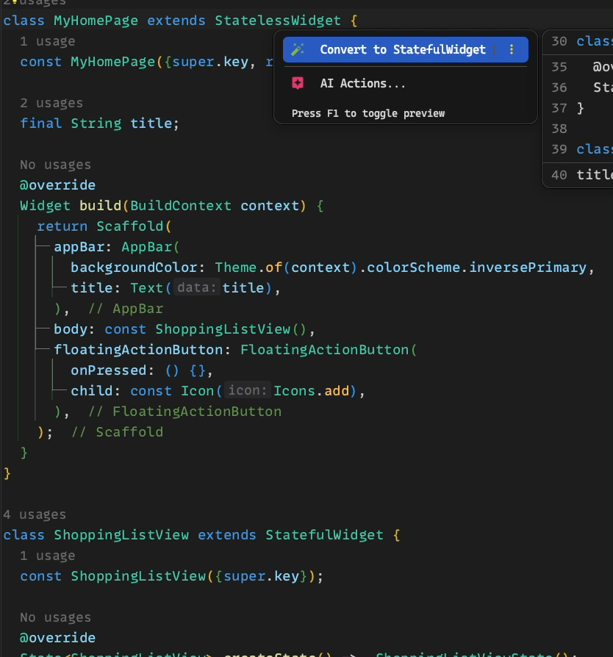
lib/main.dart
@override Widget build(BuildContext context) { return ListView.builder( itemCount: _shoppingList.items.length, itemBuilder: (context, index) { final item = _shoppingList.items[index]; return _ShoppingListItemTile( key: ValueKey(item.id), item: item, ); }, ); }
Notes:
Als erstes: MyHomePage in Stateful Widget konvertieren (via IDE)

Slide 267
lib/main.dart
class _MyHomePageState extends State<MyHomePage> { ShoppingList _shoppingList = ShoppingList() ..addItem( name: 'Banana', quantity: 3, ) ..addItem( name: 'Apple', quantity: 5, ); … }
Notes:
_shoppingList in _myHomePageState ziehen

Slide 268
lib/main.dart
class ShoppingListView extends StatefulWidget { const ShoppingListView({super.key}); @override State<ShoppingListView> createState() => _ShoppingListViewState(); } class _ShoppingListViewState extends State<ShoppingListView> { @override Widget build(BuildContext context) { return ListView.builder( itemCount: _shoppingList.items.length, itemBuilder: (context, index) { final item = _shoppingList.items[index]; return _ShoppingListItemTile( key: ValueKey(item.id), item: item, ); }, ); } }
Notes:
ShoppingListView in Stateless Widget umwandeln

Slide 269
lib/main.dart
class ShoppingListView extends StatelessWidget { const ShoppingListView({super.key}); @override Widget build(BuildContext context) { return ListView.builder( itemCount: _shoppingList.items.length, itemBuilder: (context, index) { final item = _shoppingList.items[index]; return _ShoppingListItemTile( key: ValueKey(item.id), item: item, ); }, ); } }
Notes:
Das geht leider nur manuell

Slide 270
lib/main.dart
class ShoppingListView extends StatelessWidget { const ShoppingListView({ required this.shoppingList, super.key, }); final ShoppingList shoppingList; @override Widget build(BuildContext context) { return ListView.builder( itemCount: shoppingList.items.length, itemBuilder: (context, index) { final item = shoppingList.items[index]; return _ShoppingListItemTile( key: ValueKey(item.id), item: item, ); }, ); } }
Notes:
_shoppingList in _MyHomePageState ziehen

Slide 271
lib/main.dart
@override Widget build(BuildContext context) { return Scaffold( appBar: AppBar( backgroundColor: Theme.of(context).colorScheme.inversePrimary, title: Text(widget.title), ), body: const ShoppingListView(), floatingActionButton: FloatingActionButton( onPressed: () {}, child: const Icon(Icons.add), ), ); }
Notes:
_shoppingList von MyHomePage in ShoppingListView ziehen

Slide 272
lib/main.dart
@override Widget build(BuildContext context) { return Scaffold( appBar: AppBar( backgroundColor: Theme.of(context).colorScheme.inversePrimary, title: Text(widget.title), ), body: ShoppingListView( shoppingList: _shoppingList, ), floatingActionButton: FloatingActionButton( onPressed: () {}, child: const Icon(Icons.add), ), ); }
Notes:
Jetzt können wir die ShoppingList modifizieren

Slide 273
lib/main.dart
@override Widget build(BuildContext context) { return Scaffold( appBar: AppBar( backgroundColor: Theme.of(context).colorScheme.inversePrimary, title: Text(widget.title), ), body: ShoppingListView( shoppingList: _shoppingList, ), floatingActionButton: FloatingActionButton( onPressed: () { _shoppingList.addItem(name: 'New item', quantity: 1); }, child: const Icon(Icons.add), ), ); }
Notes:
Jetzt haben wir Zugriff auf die ShoppingList im FloatingActionButton

Slide 274
lib/main.dart
@override Widget build(BuildContext context) { return Scaffold( appBar: AppBar( backgroundColor: Theme.of(context).colorScheme.inversePrimary, title: Text(widget.title), ), body: ShoppingListView( shoppingList: _shoppingList,), floatingActionButton: FloatingActionButton( onPressed: () { setState(() { _shoppingList.addItem(name: 'New item', quantity: 1); }); }, child: const Icon(Icons.add), ), ); }
Notes:
setState nicht vergessen!

Slide 275

lib/main.dart
@override Widget build(BuildContext context) { return Scaffold( appBar: AppBar( backgroundColor: Theme.of(context).colorScheme.inversePrimary, title: Text(widget.title), ), body: ShoppingListView( shoppingList: _shoppingList, ), floatingActionButton: FloatingActionButton( onPressed: () { _shoppingList.addItem(name: 'New item', quantity: 1); }, child: const Icon(Icons.add), ), ); }

Slide 276
Creating a new page to add items
Shopping List App

Slide 277
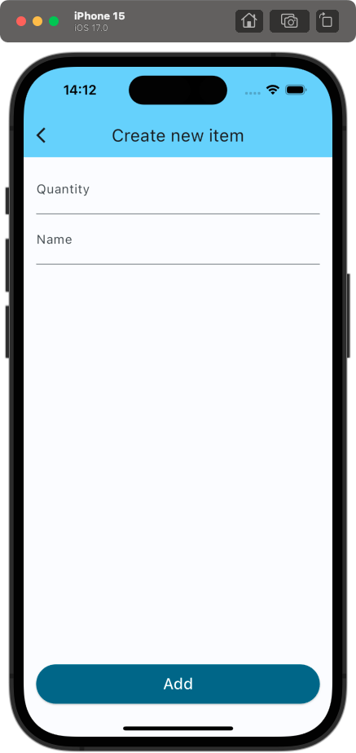
Creating a new page to add items
Shopping List App

Slide 278
Breaking down the design
Shopping List App

Slide 286
Implementing the page
Shopping List App

Slide 287
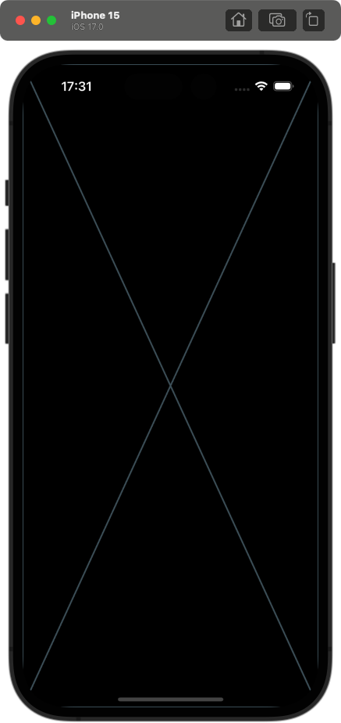
lib/main.dart
class CreateNewShoppingListItemPage extends StatelessWidget { const CreateNewShoppingListItemPage({super.key}); @override Widget build(BuildContext context) { return const Placeholder(); } }
Notes:
setState nicht vergessen!

Slide 288
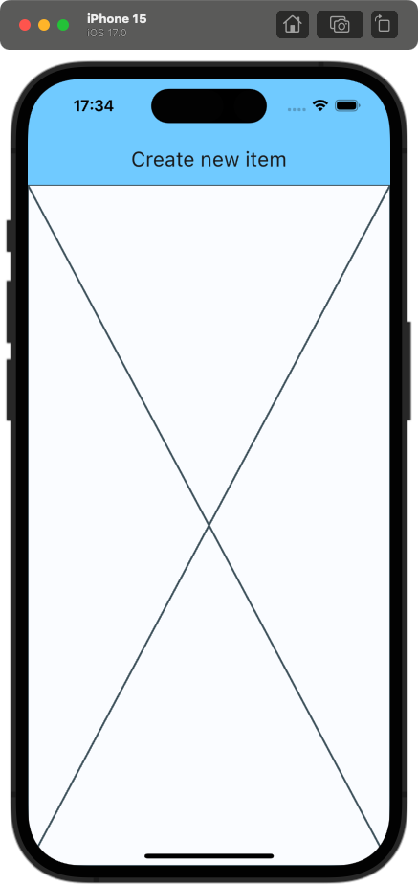
lib/main.dart
class CreateNewShoppingListItemPage extends StatelessWidget { const CreateNewShoppingListItemPage({ super.key, required this.shoppingList, }); final ShoppingList shoppingList; @override Widget build(BuildContext context) { return Scaffold( appBar: AppBar( backgroundColor: Theme.of(context).colorScheme.inversePrimary, title: const Text('Create new item'), ), body: _CreateNewItemForm( shoppingList: shoppingList, ), ); } }

Slide 289
lib/main.dart
class _CreateNewItemForm extends StatefulWidget { const _CreateNewItemForm({ super.key, required this.shoppingList, }); final ShoppingList shoppingList; @override State<_CreateNewItemForm> createState() => _CreateNewItemFormState(); }
class _CreateNewItemFormState extends State<_CreateNewItemForm> { @override Widget build(BuildContext context) { return const Placeholder(); } }

Slide 290
lib/main.dart
class _CreateNewItemFormState extends State<_CreateNewItemForm> { @override Widget build(BuildContext context) { return Form( child: , ); } }

Slide 291
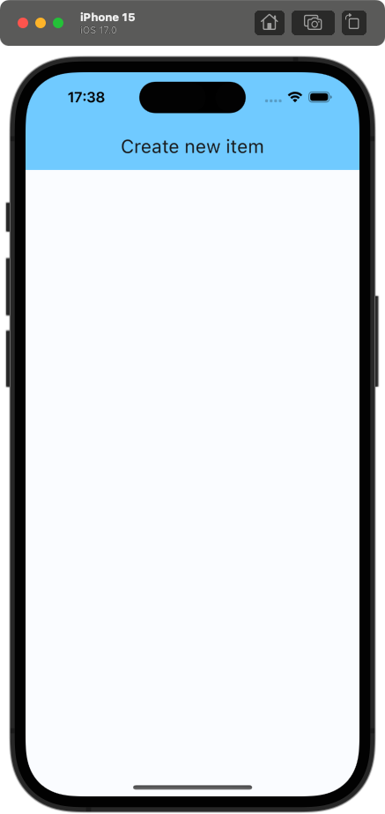
lib/main.dart
class _CreateNewItemFormState extends State<_CreateNewItemForm> { @override Widget build(BuildContext context) { return Form( child: Column( children: [], ), ); } }

Slide 292
Column
“A widget that displays its children in a vertical array.“

Slide 293
Row
“A widget that displays its children in a horizontal array.“

Slide 294
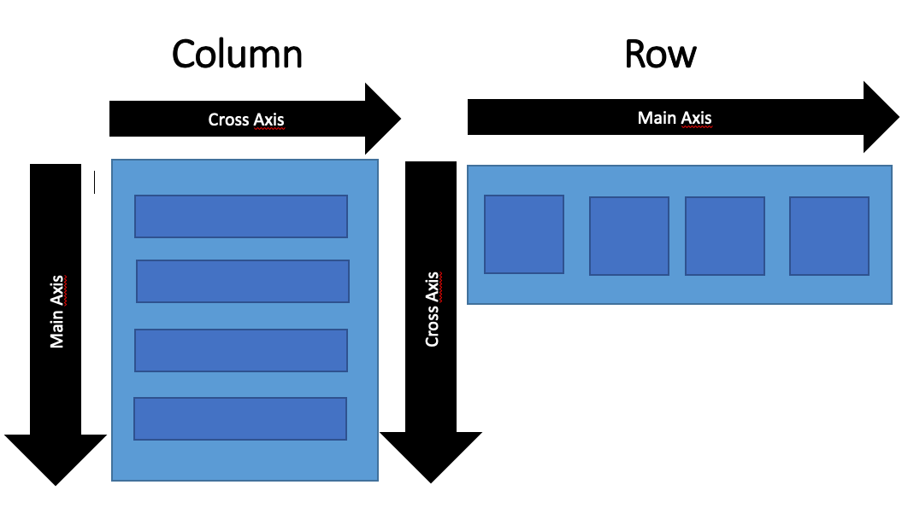
Column/Row
children: “The widgets below this widget in the tree.“
mainAxisAlignment: “How the children should be placed along the main axis.“
mainAxisSize: “How much space should be occupied in the main axis.“
crossAxisAlignment: “How the children should be placed along the cross axis.“
see all properties here

Slide 295
Column/Row vs. Flexbox
mainAxisAlignment
justify-content
start
end
center
spaceBetween
spaceAround
spaceEvenly
start
end
center
space-between
space-around
space-evenly

Slide 296
Column/Row vs. Flexbox
crossAxisAlignment
align-items
start
end
center
stretch
baseline
start
end
center
stretch
baseline

Slide 297
Column/Row vs. Flexbox
Expanded
flex
“A widget that expands a child of Row, Column, or Flex so that the child fills the available space.“
”flex CSS shorthand property sets how a flex item will grow or shrink to fit the space available in its flex container.“

Slide 298
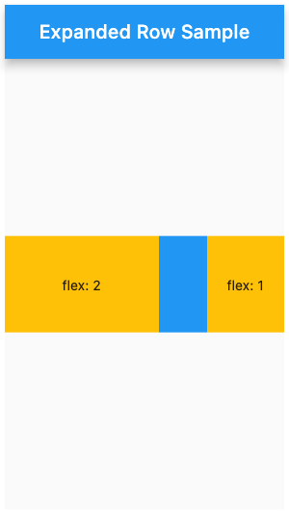
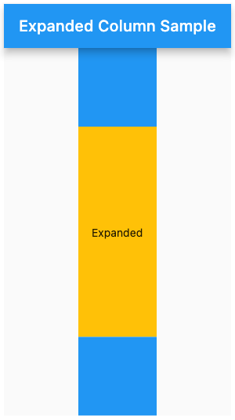
Expanded

Slide 299
lib/main.dart
class _CreateNewItemFormState extends State<_CreateNewItemForm> { @override Widget build(BuildContext context) { return Form( child: Column( children: [], ), ); } }

Slide 300
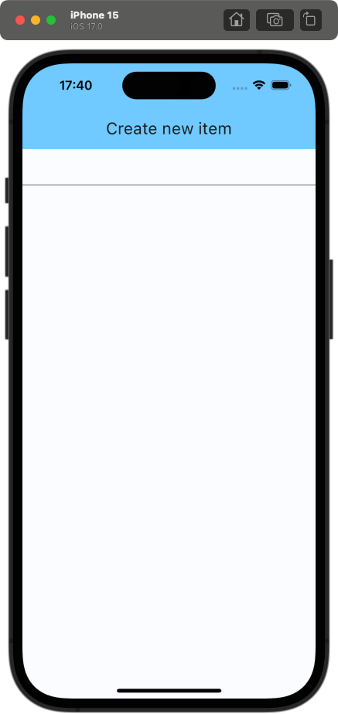
lib/main.dart
class _CreateNewItemFormState extends State<_CreateNewItemForm> { @override Widget build(BuildContext context) { return Form( child: Column( children: [ TextFormField(), ], ), ); } }
Notes:
setState nicht vergessen!

Slide 301
TextFormField
“A FormField that contains a TextField. This is a convenience widget that wraps a TextField widget in a FormField.“
Notes:
TextField mit zusätzlichen Properties, die für ein Benutzen in einer Form nützlich sind

Slide 302
TextFormField
decoration: “The decoration to show around the text field.“
controller: “Controls the text being edited.“
validator: “An optional method that validates the input. Returns an error string to display if the input is invalid, or null otherwise.“
see all properties here
Notes:
Padding ist nicht wie in CSS durch einen string oder eine Zahl definiert, sondern durch die EdgeInsets Klasse

Slide 303
lib/main.dart
class _CreateNewItemFormState extends State<_CreateNewItemForm> { @override Widget build(BuildContext context) { return Form( child: Column( children: [ TextFormField(), ], ), ); } }

Slide 304
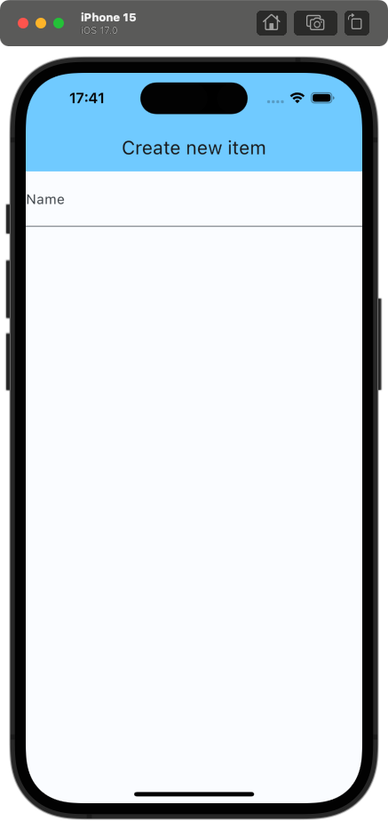
lib/main.dart
class _CreateNewItemFormState extends State<_CreateNewItemForm> { @override Widget build(BuildContext context) { return Form( child: Column( children: [ TextFormField( decoration: InputDecoration( labelText: 'Name', ), ), ], ), ); } }
👆 give TextField label
Notes:
Ist gerade ein wenig eingeengt

Slide 305
Padding
“A widget that insets its child by the given padding.“

Slide 306
Padding
child: “The widget below this widget in the tree.“
padding: “The amount of space by which to inset the child.“
see all properties here
Notes:
Padding ist nicht wie in CSS durch einen string oder eine Zahl definiert, sondern durch die EdgeInsets Klasse

Slide 307
Understanding EdgeInsets
Shopping List App

Slide 308
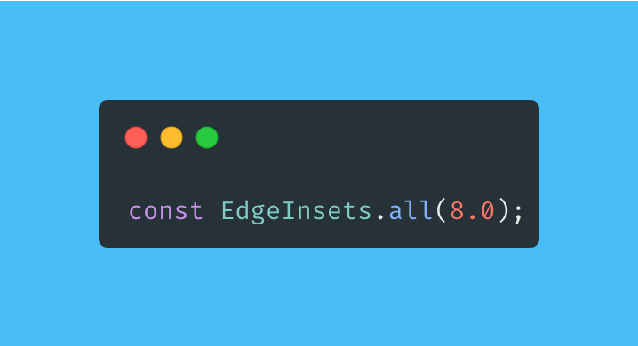
EdgeInsets.all

Slide 309
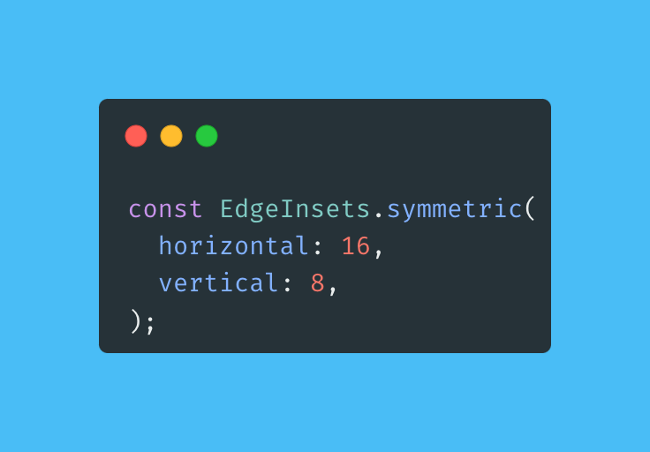
EdgeInsets.symmetric

Slide 310

EdgeInsets.fromLTRB

Slide 311

EdgeInsets.only

Slide 312
lib/main.dart
class _CreateNewItemFormState extends State<_CreateNewItemForm> { @override Widget build(BuildContext context) { return Form( child: Column( children: [ TextFormField( decoration: InputDecoration( labelText: 'Name', ), ), ], ), ); } }

Slide 313

lib/main.dart
@override Widget build(BuildContext context) { return Padding( padding: const EdgeInsets.symmetric( horizontal: 16, vertical: 8, ), child: Form( child: Column( children: [ TextFormField( decoration: InputDecoration( labelText: 'Name', ), ), ], ), ), ); }
Notes:
Jetzt fehlt noch das zweite TextField und der Button

Slide 314

lib/main.dart
@override Widget build(BuildContext context) { return Padding( padding: const EdgeInsets.symmetric( horizontal: 16, vertical: 8, ), child: Form( child: Column( children: [ TextFormField( decoration: InputDecoration( labelText: 'Name', ), ), ], ), ), ); }
Notes:
Wrappen geht einfach mit Shortcut (Option + Enter)

Slide 315

lib/main.dart
[ TextFormField( decoration: InputDecoration( labelText: 'Quantity', ), ), TextFormField( decoration: InputDecoration( labelText: 'Name', ), ), ElevatedButton( onPressed: () {}, child: const Text('Add'), ), ]

Slide 316

lib/main.dart
ElevatedButton( style: ElevatedButton.styleFrom( backgroundColor: Theme.of(context).colorScheme.primary, foregroundColor: Theme.of(context).colorScheme.onPrimary, minimumSize: const Size.fromHeight(50.0), ), onPressed: () {}, child: const Text( 'Add', style: TextStyle(fontSize: 20), ), ),
Notes:
Wir wollen den Button nach ganz unten bewegen => Die TextFelder müssen den ganzen Space ausfüllen

Slide 317

lib/main.dart
[ Expanded( child: Column( children: [ TextFormField( ... ), TextFormField( ... ), ], ), ), ElevatedButton( ... ), ]
Notes:
Alternative Lösung: mainAxisAlignment der äußeren Column auf MainAxisAlignment.spaceBetween setzen
Der Button liegt jetzt irgendwie unter einem Control vom iPhone => wie verhindern wir das? Man könnte natürlich einfach ein wenig Bottom-Padding geben, allerdings ist dieser Wert auf jedem Device anders

Slide 318
SafeArea
“A widget that insets its child by sufficient padding to avoid intrusions by the operating system.“
Notes:
Dafür gibt es SafeArea

Slide 319

lib/main.dart
return SafeArea( child: ... );
Notes:
Wir wrappen alles in einer SafeArea => Tada

Slide 320
Capturing Input
Shopping List App

Slide 321
Capturing Input
Two viable approaches

Slide 322
Capturing Input
Two viable approaches
Using a state variable and setting it in the onChanged callback of the TextFormField
Using a TextEditingController

Slide 323
Capturing Input
State variables
TextEditingController
Rerenders the whole widget tree when the input changes
Useful when the input is displayed somewhere else than the TextField itself
Only rerenders the TextField
Requires disposing and initializing

Slide 324
lib/main.dart
class _CreateNewItemFormState extends State<_CreateNewItemForm> { late final TextEditingController _quantityController; late final TextEditingController _nameController; ... }
Notes:
setState nicht vergessen!

Slide 325
lib/main.dart
class _CreateNewItemFormState extends State<_CreateNewItemForm> { late final TextEditingController _quantityController; late final TextEditingController _nameController; ... }
👆 tells the compiler that _nameController is initialized before being used
Notes:
setState nicht vergessen!

Slide 326
lib/main.dart
class _CreateNewItemFormState extends State<_CreateNewItemForm> { late final TextEditingController _quantityController; late final TextEditingController _nameController; @override void initState() { super.initState(); _quantityController = TextEditingController(); _nameController = TextEditingController(); }
... }
Notes:
setState nicht vergessen!

Slide 327
Lifecycle methods of a StatefulWidget
Shopping List App

Slide 328
Lifecycle methods of a StatefulWidget (processed in order)
createState()
mounted = true
initState()
didChangeDependencies()
build()
didUpdateWidget()
setState()
deactivate()
dispose()
mounted = false

Slide 329
Lifecycle methods of a StatefulWidget (processed in order)
createState()
mounted = true
initState()
didChangeDependencies()
build()
didUpdateWidget()
setState()
deactivate()
dispose()
mounted = false
Notes:
Wirklich relevant sind nur diese

Slide 330
initState()
Is the first method called after the creation of the widget
Only called once!
Must call super.initState() before doing anything else
Useful for:
Initializing data that relies on the BuildContext
Initializing properties that rely on properties from the widget itself
Subscribing to any object that could change the data on the widget

Slide 331
Lifecycle methods of a StatefulWidget
createState()
mounted = true
initState()
didChangeDependencies()
build()
didUpdateWidget()
setState()
deactivate()
dispose()
mounted = false

Slide 332
build()
Called on every render => Called very often!
Must return a widget

Slide 333
Lifecycle methods of a StatefulWidget
createState()
mounted = true
initState()
didChangeDependencies()
build()
didUpdateWidget()
setState()
deactivate()
dispose()
mounted = false

Slide 334
dispose()
Called when the state is permantently removed from the tree
Needs to call super.dispose() after everything else
Useful for:
Unsubscribing
Cancelling animations
Calling dispose methods of state members (e.g. TextEditingController)

Slide 335
Lifecycle methods of a StatefulWidget
createState()
mounted = true
initState()
didChangeDependencies()
build()
didUpdateWidget()
setState()
deactivate()
dispose()
mounted = false

Slide 336
Handling the lifecycle of a TextEditingController
Shopping List App

Slide 337
lib/main.dart
class _CreateNewItemFormState extends State<_CreateNewItemForm> { late final TextEditingController _quantityController; late final TextEditingController _nameController; @override void initState() { super.initState(); _quantityController = TextEditingController(); _nameController = TextEditingController(); }
... }

Slide 338
lib/main.dart
class _CreateNewItemFormState extends State<_CreateNewItemForm> { late final TextEditingController _quantityController; late final TextEditingController _nameController; @override void initState() { super.initState(); _quantityController = TextEditingController(); _nameController = TextEditingController(); } @override void dispose() { _quantityController.dispose(); _nameController.dispose(); super.dispose(); } ... }

Slide 339
lib/main.dart
[ TextFormField( decoration: InputDecoration( labelText: 'Quantity', ), ), TextFormField( decoration: InputDecoration( labelText: 'Name', ), ), ]
Notes:
setState nicht vergessen!

Slide 340
lib/main.dart
[ TextFormField( controller: _quantityController, decoration: InputDecoration( labelText: 'Quantity', ), ), TextFormField( controller: _nameController, decoration: InputDecoration( labelText: 'Name', ), ), ]
Notes:
setState nicht vergessen!

Slide 341
Shopping list app
Adding validation

Slide 342
lib/main.dart
[ TextFormField( controller: _quantityController, decoration: InputDecoration( labelText: 'Quantity', ), ), TextFormField( controller: _nameController, decoration: InputDecoration( labelText: 'Name', ), ), ]
Notes:
setState nicht vergessen!

Slide 343
lib/main.dart
[ TextFormField( controller: _quantityController, keyboardType: TextInputType.numberWithOptions( decimal: false, signed: false, ), decoration: InputDecoration( labelText: 'Quantity', ), ), TextFormField( validator: (value) { if (value == null || value.isEmpty) { return 'Please enter a name'; } return null; }, controller: _nameController, decoration: InputDecoration( labelText: 'Name', ), ), ]
Notes:
setState nicht vergessen!

Slide 344
lib/main.dart
final _formKey = GlobalKey<FormState>(); @override Widget build(BuildContext context) { return SafeArea( child: Padding( padding: ..., child: Form( key: _formKey, child: ... ), ), ); }
👆uniquely identifies the form and allows validation
Notes:
setState nicht vergessen!

Slide 345
lib/main.dart
ElevatedButton( style: ElevatedButton.styleFrom( backgroundColor: Theme.of(context).colorScheme.primary, foregroundColor: Theme.of(context).colorScheme.onPrimary, minimumSize: const Size.fromHeight(50.0), ), onPressed: () {}, child: const Text( 'Add', style: TextStyle(fontSize: 20), ), ),
Notes:
setState nicht vergessen!

Slide 346
lib/main.dart
ElevatedButton( style: ..., onPressed: () { if (!_formKey.currentState!.validate()) { return; } }, child: ..., ),
Notes:
setState nicht vergessen!

Slide 347
Extracting Input
Shopping List App

Slide 348
lib/main.dart
ElevatedButton( style: ..., onPressed: () { if (!_formKey.currentState!.validate()) { return; } }, child: ..., ),
Notes:
setState nicht vergessen!

Slide 349
lib/main.dart
ElevatedButton( style: ..., onPressed: () { if (!_formKey.currentState!.validate()) { return; }
final quantity = int.tryParse(_quantityController.text) ?? 1;
final name = _nameController.text; }, child: ..., ),
Notes:
setState nicht vergessen!

Slide 350
lib/main.dart
ElevatedButton( style: ..., onPressed: () { if (!_formKey.currentState!.validate()) { return; }
final quantity = int.tryParse(_quantityController.text) ?? 1;
final name = _nameController.text; }, child: ..., ),
Null operator 👇

Slide 351
lib/main.dart
ElevatedButton( style: ..., onPressed: () { if (!_formKey.currentState!.validate()) { return; }
final quantity = int.tryParse(_quantityController.text) ?? 1; final name = _nameController.text;
widget.shoppingList.addItem( name: name, quantity: quantity, );
}, child: ..., ),
Notes:
Nun wollen wir zurück zur Ansicht mit der ShoppingList => Wie werden wir den aktuellen Bildschirm los?

Slide 352
Navigation to the new Page
Shopping List App

Slide 353
Navigators
Navigator 1.0
Navigator 2.0
Imperative API
Limited control over navigation stack
Easy to use
Sufficient for many usecases
Declarative API
Full control
Complex
Mostly used via third party packages like auto_route or go_router

Slide 354
Navigators
Navigator 1.0
Navigator 2.0
👈 We will use the simpler approach
Imperative API
Limited control over navigation stack
Easy to use
Sufficient for many usecases
Declarative API
Full control
Complex
Mostly used via third party packages like auto_route or go_router

Slide 355

Pushing new pages

Slide 356

Popping pages

Slide 357
lib/main.dart
ElevatedButton( style: ..., onPressed: () { if (!_formKey.currentState!.validate()) { return; }
final quantity = int.tryParse(_quantityController.text) ?? 1; final name = _nameController.text;
widget.shoppingList.addItem( name: name, quantity: quantity, );
}, child: ..., ),
Notes:
Nun wollen wir zurück zur Ansicht mit der ShoppingList => Wie werden wir den aktuellen Bildschirm los?

Slide 358
lib/main.dart
ElevatedButton( style: ..., onPressed: () { if (!_formKey.currentState!.validate()) { return; }
final quantity = int.tryParse(_quantityController.text) ?? 1; final name = _nameController.text;
widget.shoppingList.addItem( name: name, quantity: quantity, );
Navigator.pop(context);
}, child: ..., ),

Slide 359
lib/main.dart
FloatingActionButton( onPressed: () { setState(() { _shoppingList.addItem(name: 'New item', quantity: 1); }); }, child: const Icon(Icons.add), )

Slide 360
lib/main.dart
FloatingActionButton( onPressed: () async { await Navigator.push(
context, MaterialPageRoute( builder: (context) { return CreateNewShoppingListItemPage( shoppingList: _shoppingList, ); }, ), ); }, child: const Icon(Icons.add), )
Notes:
ganz kurz async await erwähnen

Slide 361
lib/main.dart
FloatingActionButton( onPressed: () async { await Navigator.push(
context, MaterialPageRoute( builder: (context) { return CreateNewShoppingListItemPage( shoppingList: _shoppingList, ); }, ), ); if(mounted) { setState(() { // rerender }); } }, child: const Icon(Icons.add), )
👈 check if the widget is still mounted after an asynchronous operation

Slide 362

lib/main.dart
FloatingActionButton( onPressed: () async { await Navigator.push(
context, MaterialPageRoute( builder: (context) { return CreateNewShoppingListItemPage( shoppingList: _shoppingList, ); }, ), ); if(mounted) { setState(() { // rerender }); } }, child: const Icon(Icons.add), )
Notes:
App fertig, aber: Irgendwie unschön die ShoppingList den ganzen Widget-Tree hinabreichen zu müssen => geht das besser?

Slide 363

lib/main.dart
FloatingActionButton( onPressed: () async { await Navigator.push(
context, MaterialPageRoute( builder: (context) { return CreateNewShoppingListItemPage( shoppingList: _shoppingList, ); }, ), ); if(mounted) { setState(() { // rerender }); } }, child: const Icon(Icons.add), )
Notes:
App fertig, aber: Irgendwie unschön die ShoppingList den ganzen Widget-Tree hinabreichen zu müssen => geht das besser?

Slide 364
Advanced state management
The problem

Slide 365
MyApp
MyHomePage
ShoppingListView
CreateNewShoppingListItemPage
_ShoppingListItemTile
_ShoppingListItemTile
_CreateNewItemForm
…

Slide 366
MyApp
MyHomePage
shoppingList
ShoppingListView
CreateNewShoppingListItemPage
_ShoppingListItemTile
_ShoppingListItemTile
_CreateNewItemForm
…

Slide 367
MyApp
MyHomePage
shoppingList
ShoppingListView
shoppingList
CreateNewShoppingListItemPage
_ShoppingListItemTile
_ShoppingListItemTile
_CreateNewItemForm
…

Slide 368
MyApp
MyHomePage
shoppingList
ShoppingListView
shoppingList
CreateNewShoppingListItemPage
shoppingList
_ShoppingListItemTile
_ShoppingListItemTile
_CreateNewItemForm
…

Slide 369
MyApp
MyHomePage
shoppingList
ShoppingListView
shoppingList
CreateNewShoppingListItemPage
shoppingList
_ShoppingListItemTile
_ShoppingListItemTile
_CreateNewItemForm
shoppingList
…

Slide 370
MyApp
MyHomePage
shoppingList
ShoppingListView
shoppingList
CreateNewShoppingListItemPage
shoppingList
_ShoppingListItemTile
_ShoppingListItemTile
_CreateNewItemForm
shoppingList
…

Slide 371
MyApp
MyHomePage
shoppingList
ShoppingListView
shoppingList
CreateNewShoppingListItemPage
shoppingList
_ShoppingListItemTile
_ShoppingListItemTile
_CreateNewItemForm
shoppingList
…

Slide 372
Advanced state management
The idea

Slide 373
MyApp
MyHomePage
shoppingList
ShoppingListView
shoppingList
CreateNewShoppingListItemPage
shoppingList
_ShoppingListItemTile
_ShoppingListItemTile
_CreateNewItemForm
shoppingList
…

Slide 374
MyApp
SomeWidget
MyHomePage
shoppingList
ShoppingListView
shoppingList
CreateNewShoppingListItemPage
shoppingList
_ShoppingListItemTile
_ShoppingListItemTile
_CreateNewItemForm
shoppingList
…

Slide 375
MyApp
SomeWidget
shoppingList
MyHomePage
ShoppingListView
CreateNewShoppingListItemPage
_ShoppingListItemTile
_ShoppingListItemTile
_CreateNewItemForm
…

Slide 376
MyApp
SomeWidget
shoppingList
MyHomePage
ShoppingListView
CreateNewShoppingListItemPage
_ShoppingListItemTile
_ShoppingListItemTile
_CreateNewItemForm
…

Slide 377
Advanced state management
Options

Slide 378

Provider

Slide 379

Provider
bloc

Slide 380

Provider
bloc
riverpod

Slide 381

Provider
bloc
riverpod
redux

Slide 382

Provider
bloc
riverpod
redux
GetX

Slide 383

Provider
bloc
riverpod
redux
GetX

Slide 384


Slide 385

Summary
Widgets are used to configure other widgets
There is a widget for everything
Rerender using setState
Navigate between pages using the Navigator API
Use lifecycle methods to handle lifetime of created objects

Slide 386
Practice makes perfect
Build your own app

Slide 387
Requirements
Flutter installation

Slide 388

Requirements
Flutter installation

Slide 389
Requirements
Flutter installation
A physical device or an emulator

Slide 390

Requirements
Flutter installation
A physical device or an emulator
A little patience

Slide 391
Requirements
Flutter installation
A physical device or an emulator
A little patience
Creativity

Slide 392
Assignment
Brainstorm: Take 5 minutes to conceptualize a simple app idea
Initialize: Create a new Flutter project
Design: Use your gained knowledge about widgets (Scaffold, AppBar, Text, …) to build the UI
Function: Implement basic functionality and use your knowledge on state management
Style: Add a touch of customization to make your app stand out

Slide 393

It’s a competition

Slide 394

Don’t be afraid to ask for help

Slide 395

Apps & slides

Slide 396


Slide 397


Slide 398
Outlook

Slide 399


Slide 401


Slide 402
Things to lookup yourself
InheritedWidget
Element & RenderObject
Bloc & Provider
Asynchronous Dart => Call a REST-API from your Flutter app
Freezed & JSON Serializable
Widget/Unit/Integration Tests
Local Storage

